Slide 1



Slide 2
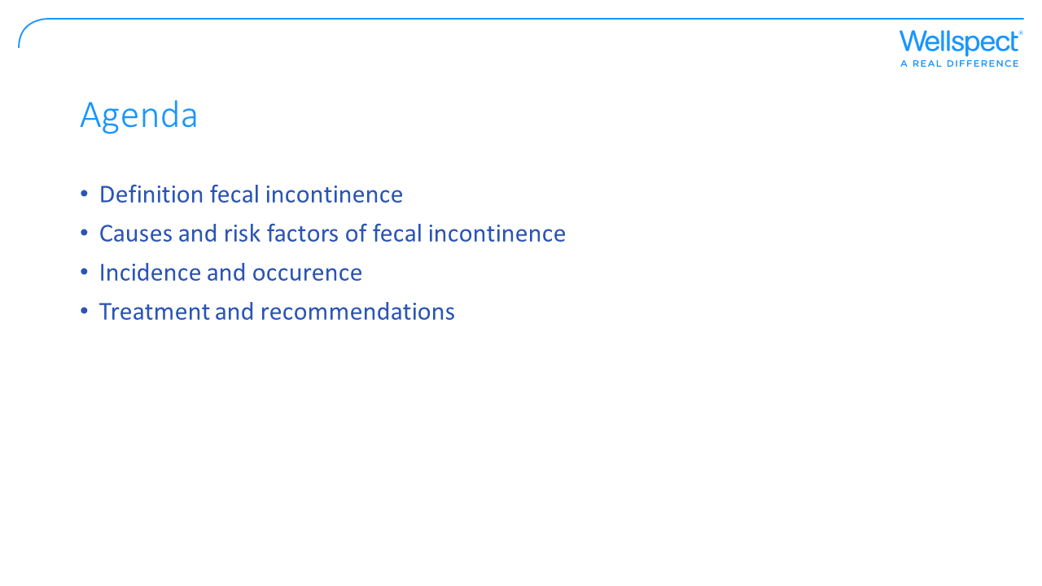
Notes:
The purpose of this presentation is to give you an overview of fecal incontinence; its cause, prevalence, and management. Bowel continence is one of our fundamental expectations and a basic element of quality of life. It reflects the confidence to have in place an adequate perception and control mechanism for feces to allow for a conscious selection of the appropriate timing, location and privacy for voiding and moving the bowels (Saldana Ruiz & Kaiser, World Journal of Gastroenterology 2017).
This presentation has been reviewed by a healthcare professional.

Slide 3
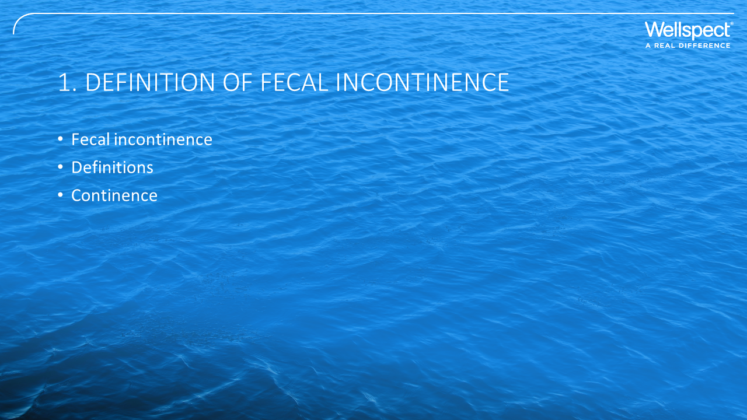

Slide 4
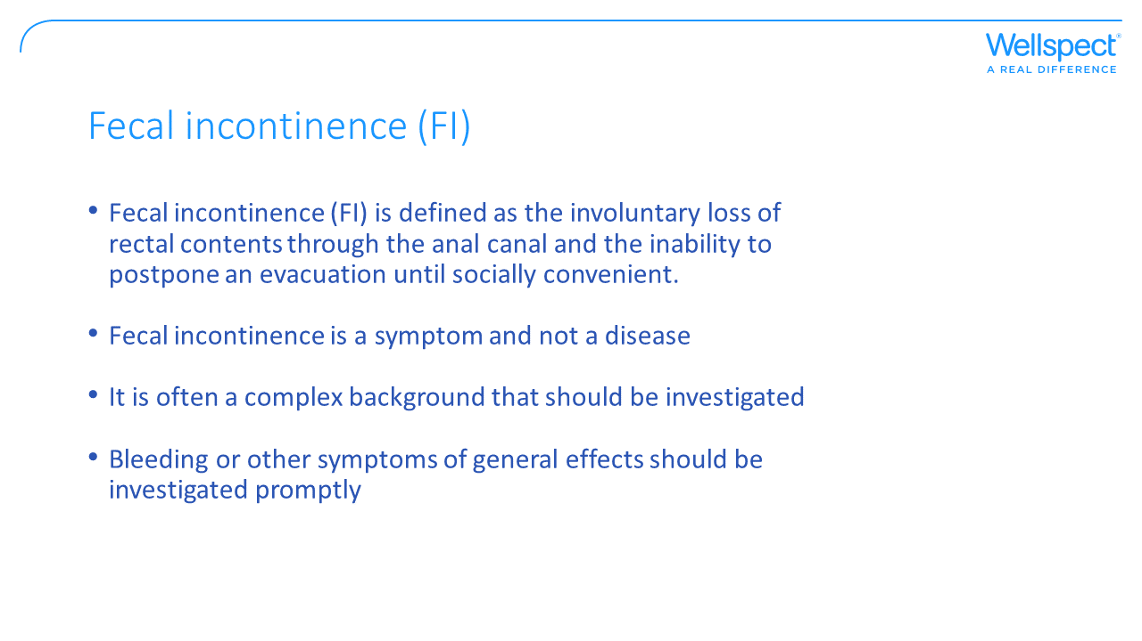
Notes:
Aim of slide: define and describe the meaning of fecal incontinence.
In addition to the definition there are a time and an age factor attached. The time factor is that the symptoms should have lasted for at least one month and the age is an age of at least 4 years with previously achieved control of continence. This definition is not always used, other define FI as the loss of feces only and use other terminology such as anal incontinence to include gas and mucus.
Not to be forgotten, FI could be a symptom of a serious disease such as a tumor or inflammatory disease.

Slide 5
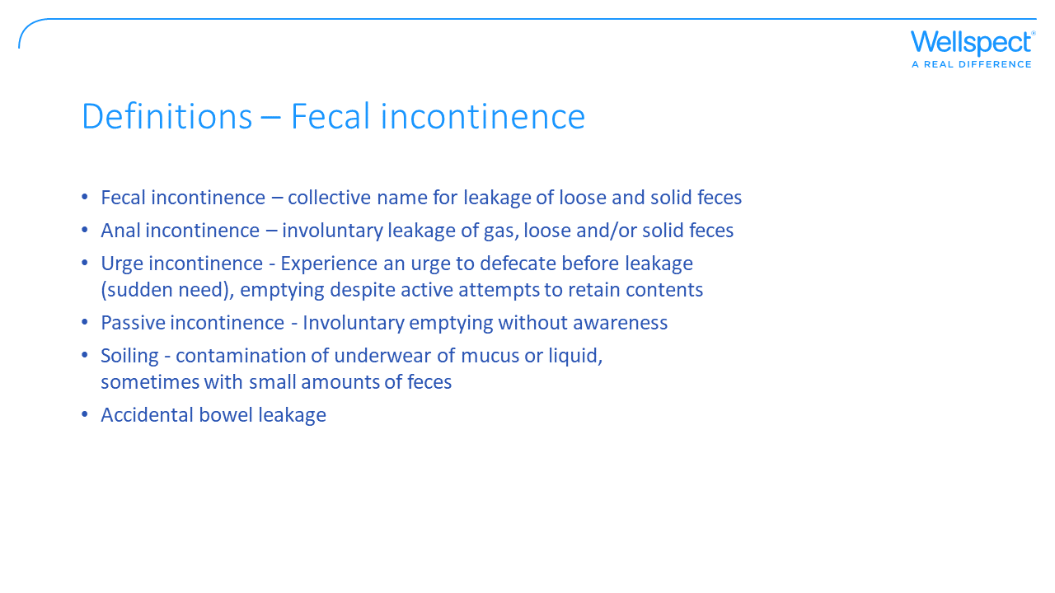
Notes:
Aim of slide: describe different types of fecal incontinence
Fecal incontinence is the collective name used for leakage of feces. There are several other words used such as anal incontinence that is when the incontinence involves both gas and feces. Flatus incontinence (leakage of gas) may be the first sign before fecal incontinence.
Urge and passive incontinence describes different symptoms of fecal incontinence. Passive incontinence is FI without any feeling of need to defecate while urge incontinence is when a sudden need is experienced without time to reach a suitable place for bowel emptying.
Accidental bowel leakage is commonly used termed for fecal incontinence and is preferred by patients to describe their condition.
Overflow incontinence occur when the patient is constipated or impacted (severe constipation) due to a large fecal mass that may have been hardened and liquid stools are able to pass around the obstruction (impaction).
For children, fecal incontinence (voluntary or involuntary) is usually not seen as an issue until over the age of four and if toilet-trained. Encopresis (or soiling) is often used to describe FI in children that do not have any anatomical defects presents while pseudoincontinence is used when children have an anatomical defect such as enlarged sigmoid colon or anal stensosis.

Slide 6
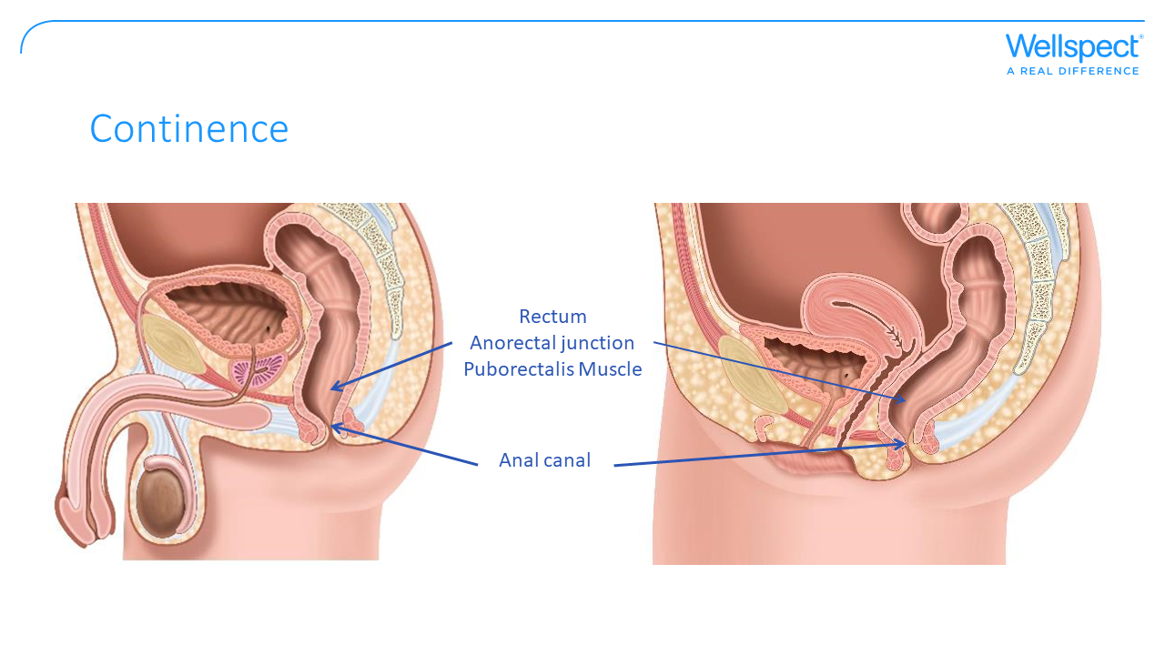

Slide 7
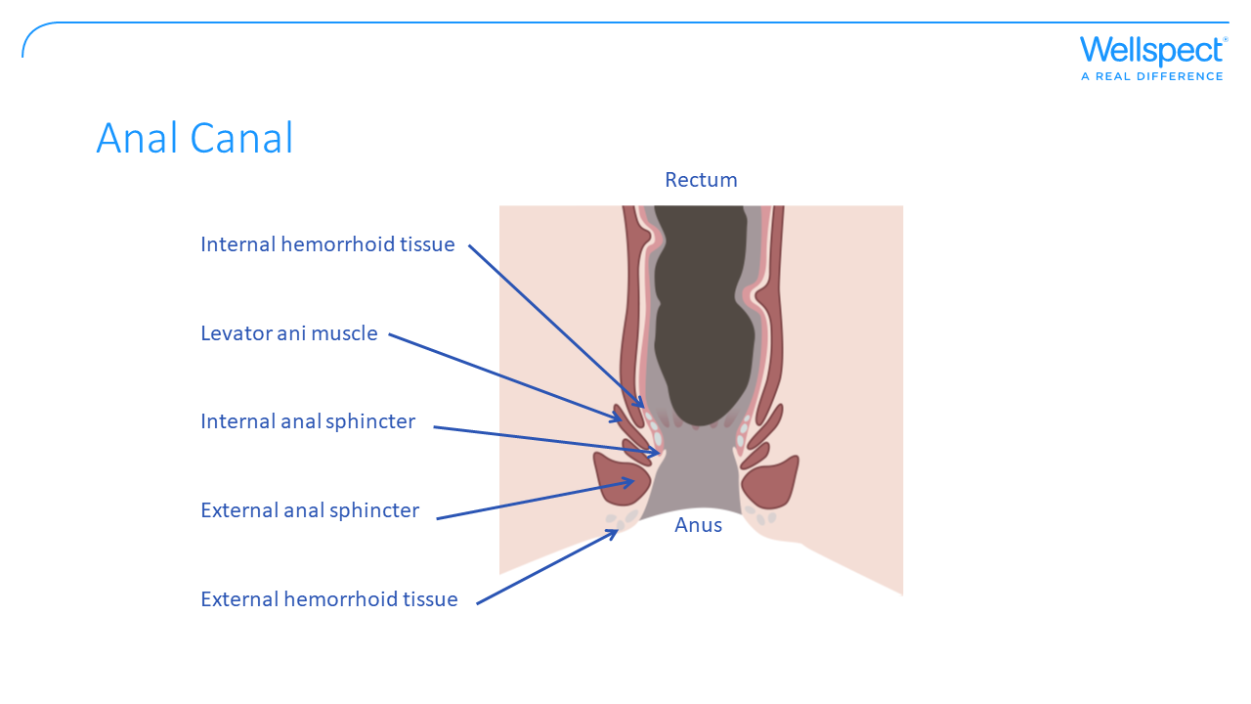
Notes:
Aim of slide: Describe the anatomy and physiology required for continence – anal canal
The sphincter muscles in the anal canal are designed to prevent unwanted bowel leakage. There are two sphincter muscles that we rely on for leakage prevention:
Internal Anal Sphincter (IAS) is a thin muscle that wraps around the anal canal and it cannot be voluntary controlled. This sphincter has a resting tightness that is designed to keep small amounts of liquid and gas from escaping unexpectedly during rest and sleep.
External Anal Sphincter (EAS) is a large thick muscle wrapped around the IAS. The EAS can be voluntary controlled.
The normal function of the sphincters are that the IAS relaxes by reflex when stool is accumulated and the rectum is distended, creating an urge to defecate. If there is no desire to defecate, EAS cleverly contracts, mechanically preventing relaxation of the IAS until the EAS is relaxed by voluntary control at a place and time that is found suitable for bowel emptying.

Slide 8
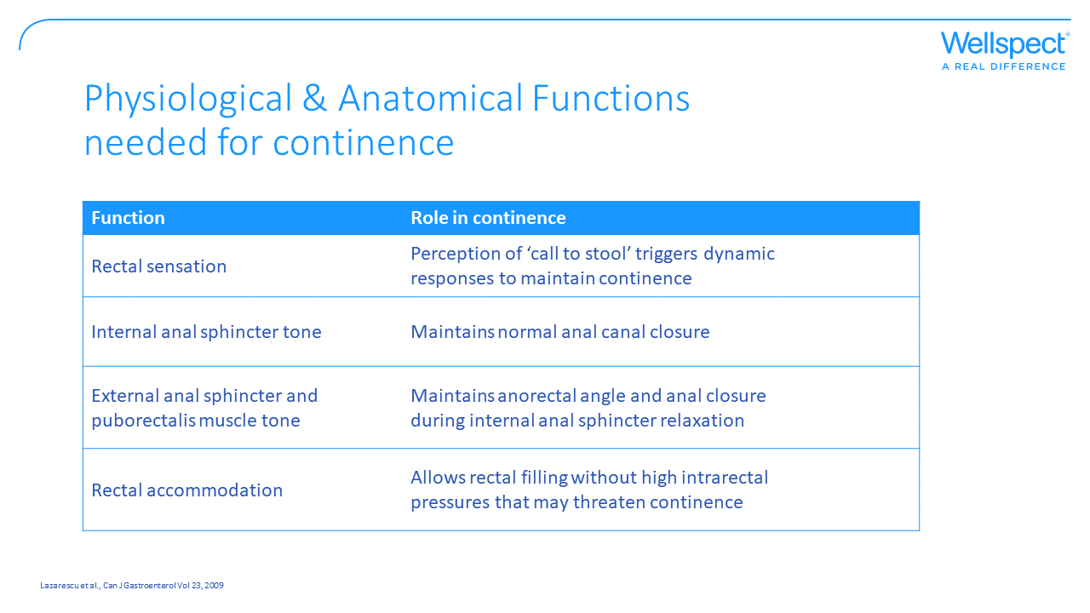
Notes:
Aim of slide: Display different physiological and anatomical functions that is needed for continence and that may be affected when fecally incontinent.
The physiological and anatomical functions needed for fecal continence can shortly be described as a reservoir that is distensible, capacious and evacuable and an effective and voluntarily controlled barrier to outflow. One other major factor that may be necessary for fecal continence is the consistency of the fecal content.

Slide 9

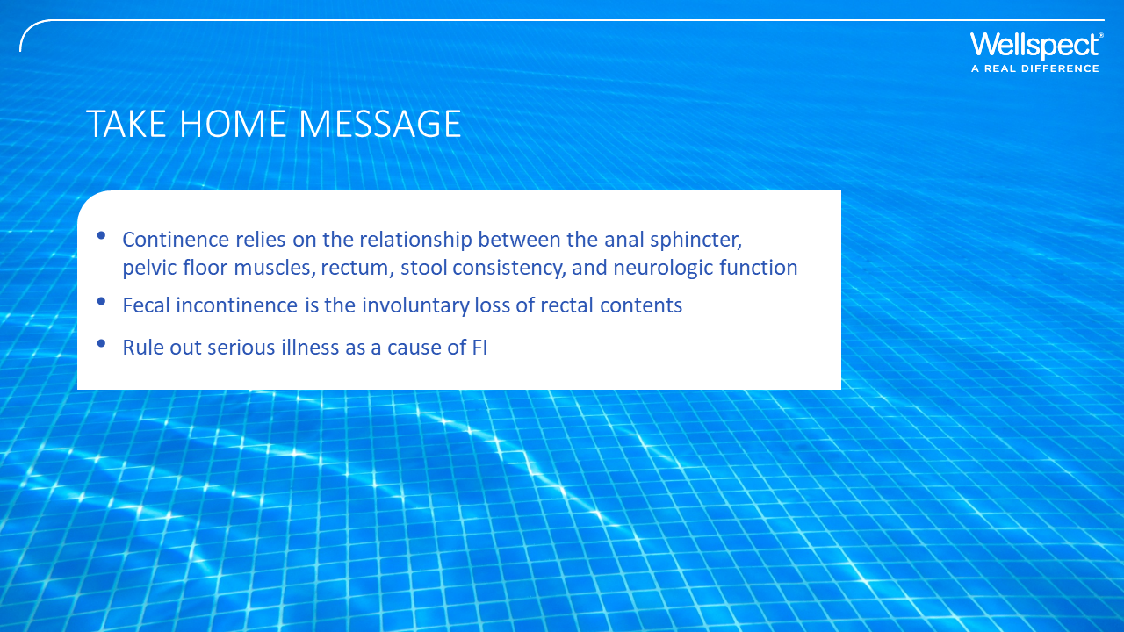

Slide 10
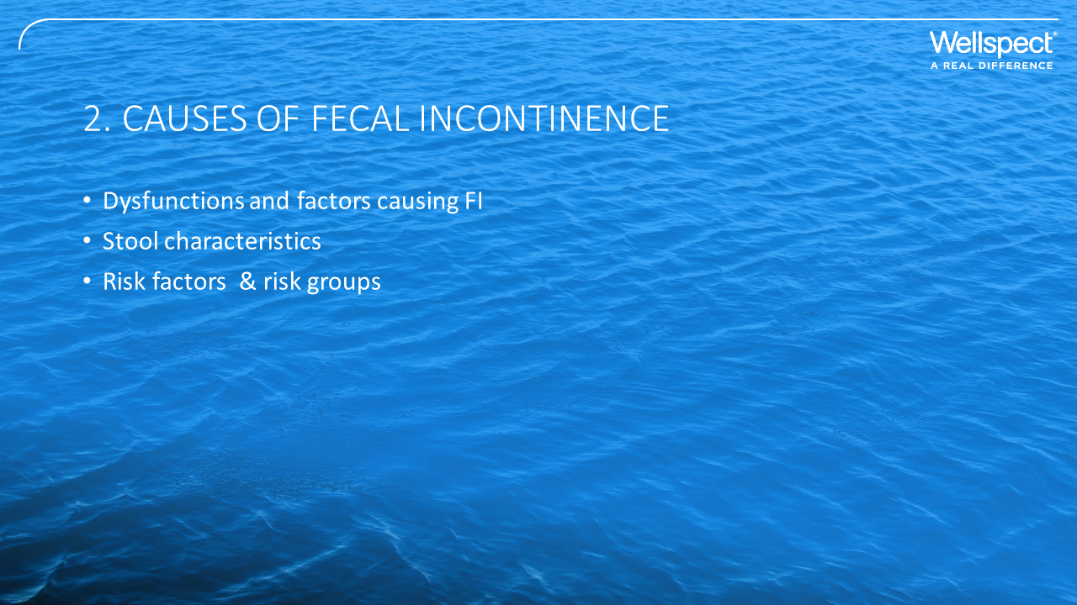

Slide 11
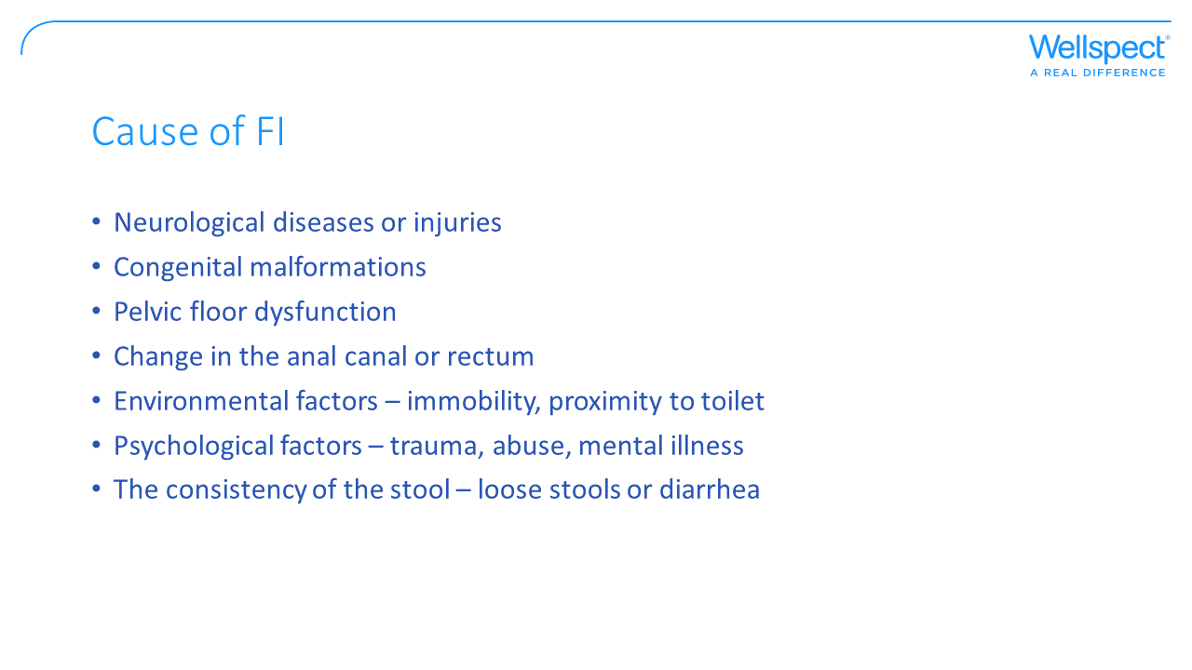
Notes:
Aim of slide: There are several different possible causes of FI, some causes may be due to underlying conditions or dysfunctions.
There are several clinical conditions that could result in fecal incontinence as well as Functional bowel disorders (FBDs) that have no other clinical conditions causing the FI. For patients with Neurogenic bowel dysfunction (NBD), FI could be a separate symptom or seen together with constipation. Congenital malformations such as anorectal malformations (ARM), spina bifida, anal atreci (born without any anal canal) or Hirshsprung’s disease could result in life-long issues with bowel management and FI. In Pelvic floor dysfunctions such as rectocele that is a bulge in rectal wall trapping stool resulting in chronic constipation, incomplete emptying and fecal incontinence. Patients with LARS have symptoms of urgency and FI due to low rectal volume and possible reduced compliance of rectal walls.
Dysfunction of one or both of the anal sphincter muscles refers to a tear or damage to the muscles surrounding the anal canal and can be due to obstetrical trauma, anal or rectal surgery such as hemorrhoidectomy, or other trauma to the rectum. In case of an obstetric injury resulting in sphincter damage the symptoms do not always present immediately, symptoms can occur later in life.
Factors such as physical mobility and cognitive function could be affected by aging, disability, dementia, and sedation.

Slide 12
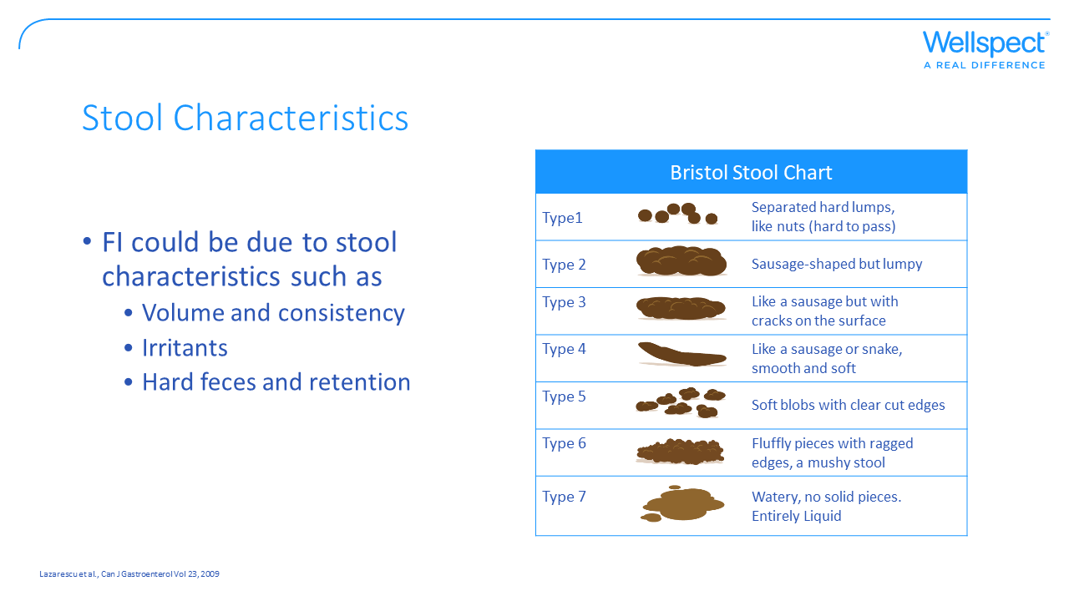
Notes:
Aim of slide: The impact of stool characteristics on fecal incontinence.
The volume and consistency of the content of rectum may be affected by conditions like inflammatory bowel disease and irritable bowel syndrome. Medications affecting the consistency of feces and bowel movement such as laxatives, anticholinergics, antidepressants, caffeine, and muscle relaxants could result in FI as well as food intolerance such as intolerance against lactose, fructose, or sorbitol.
Hard stool and retention resulting in constipation could be due to several dysfunctions or clinical conditions.
In the Bristol Stool chart, type 6-7 are more likely to cause FI as well as overflow incontinence when type 1.

Slide 13
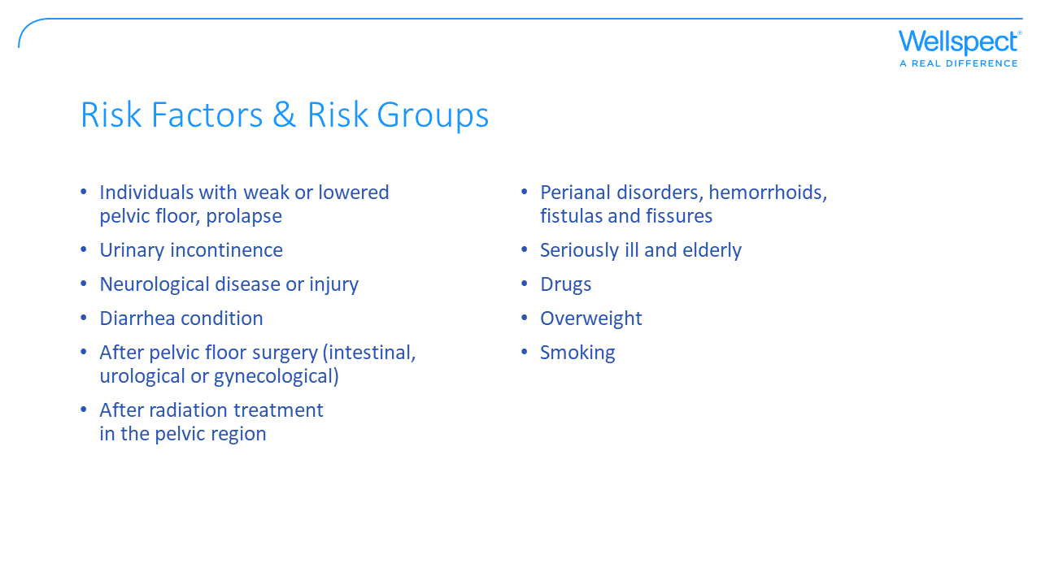
Notes:
Aim of slide: Besides the causes described there are factors that may increase the risk of FI or be a reason to ask about FI.
There are several risk factors for FI including but not limited to advanced age, depression, chronic diarrhea, rectal urgency, diabetes, urinary incontinence, inactivity, pregnancy, medications, smoking, and obesity (O’Donnell, Journal for nurse practitioners 2020;16(8)).

Slide 14
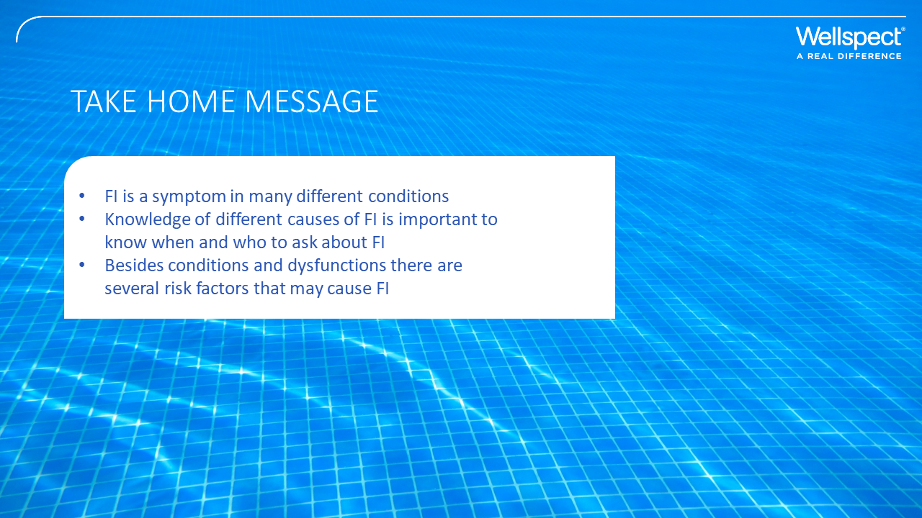

Slide 15


Slide 16
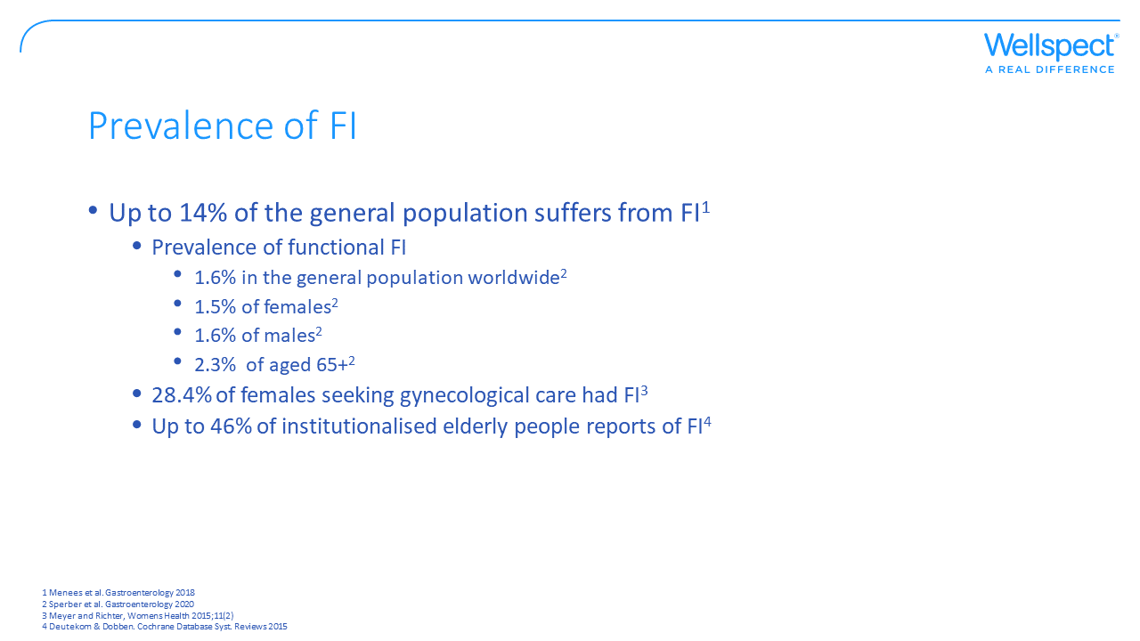
Notes:
Aim of slide: Display prevalence of fecal incontinence in general population
Patients often do not report the symptoms, making it difficult to document its prevalence. In a large population-based study up to 1 out of 7 reported FI with no difference between males and females (Menees et al. Gastroenterology 2018). Several other studies have shown a higher prevalence among women and therefore, the population believed to be most affected by FI are postmenopausal women. In females seeking gynecological care 28.4% suffered from FI (Meyer and Richter, Womens Health 2015;11(2)).
Ageing is a factor that display higher prevalence and the impact of FI is particularly seen in the elderly. But FI can occur in all ages, both men and women. Recent data from a large epidemiologic worldwide study show that 1.6% of the general population suffer from functional FI according to the Rome IV criteria and excluding underlying conditions such as organic or structural causes, surgeries and inflammatory bowel diseases. The difference between men and women are almost none and if any, it tends to be more men that suffer from functional FI (Sperber et al. Gastroenterology 2020).
Older age is correlated with idiopathic causes of FI, and with an ageing population the prevalence of such symptoms increases. In a study on institutionalised elderly people 46% have at least one incontinent episode per week (Deutekom & Dobben 2015).

Slide 17
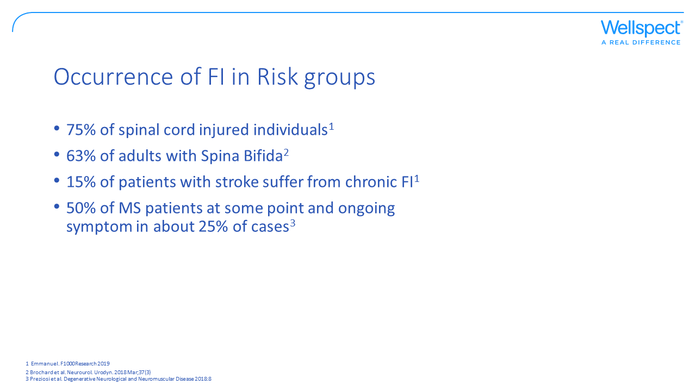
Notes:
Aim of slide: Display prevalence of fecal incontinence in specific groups of patients.
For a specific patient group up to 75% have experienced episodes of FI, as in the case for spinal cord injured individuals. Among Spina Bifida patients severe FI is common and is mainly associated with rectal abnormalities such as absence of anal canal sensitivity or low maximal tolerable volume (Brochard et al. Neurourol. Urodyn. 2018 Mar;37(3)). Neurogenic bowel dysfunction is also seen in stroke patients were up to 15% suffer from chronic FI and in MS patients were as many as 50% have had FI at some point and 25% experience FI continuously (Emmanuel. F1000Research 2019; Preziosi et al. Degenerative Neurological and Neuromuscular Disease 2018:8).

Slide 18
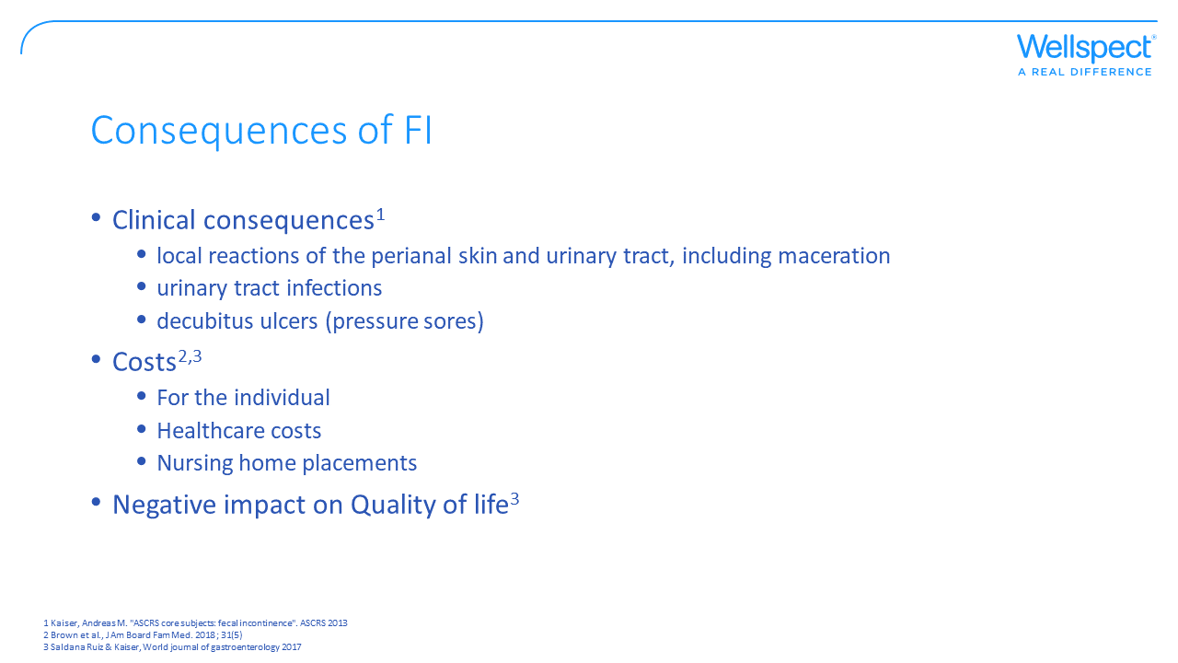
Notes:
Aim of slide: FI affects an individual in several different ways.
Consequences of FI (Saldana Ruiz & Kaiser, World Journal of Gastroenterology 2017):
Clinical consequences: the patients may develop secondary medical morbidities, such as skin deterioration, UTIs, maceration (softening and whitening of skin due to continuous moisture);
There are substantial direct and indirect financial expenses to the patients (i.e. clothes), salary/employment loss, containments;
And to the society and healthcare in form of productivity loss and healthcare visits;
Most importantly, there is a significant impact on the quality of life.
Notably, the quality of life is not limited to the patient but could to a similar degree affect the patient’s significant others. FI can contribute to the loss of the ability to live independently and is a cause of nursing home placements as well (O’Donnell, Journal for nurse practitioners 2020;16(8)).

Slide 19
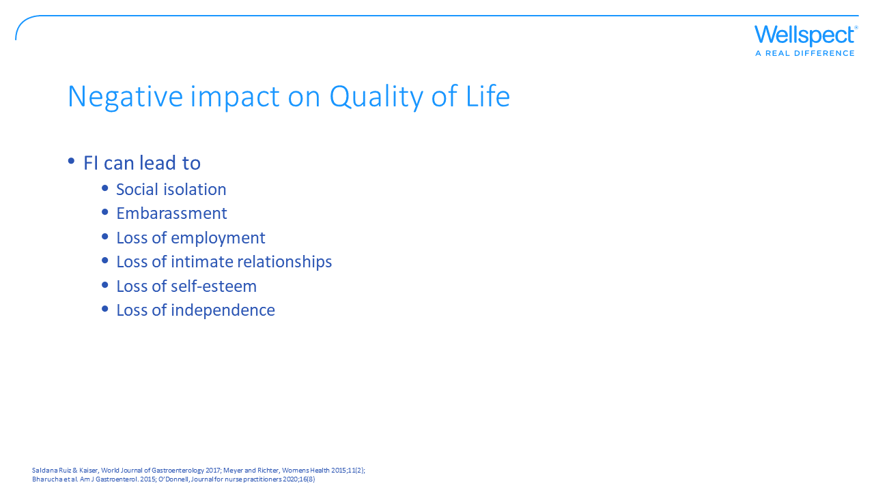
Notes:
Aim of slide: The negative impact on quality of life is related to several factors.
Fecal incontinence can adversely affect quality of life, leading to embarrassment and social isolation. FI occurs more often in older adults and is a common reason for nursing home referrals as well as it increases the burden for caregivers and strains relationships. Also, FI can hinder the ability to work for both the patient and caregiver. And even if numerous treatments are available, most persons affected by FI self-treat and often do not report their symptoms to their healthcare provider.

Slide 20
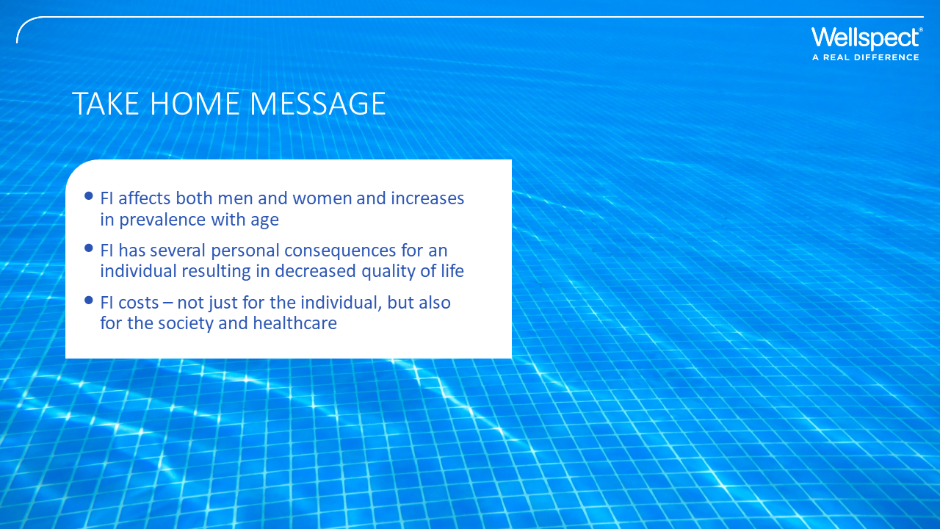

Slide 21
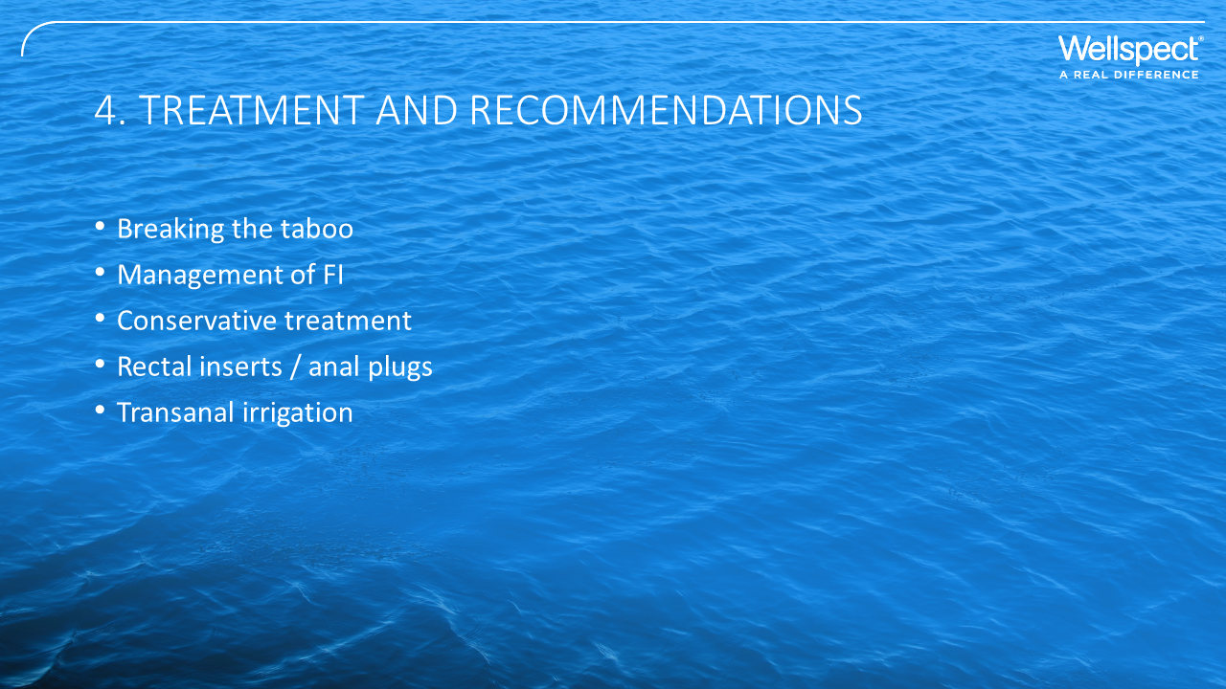

Slide 22
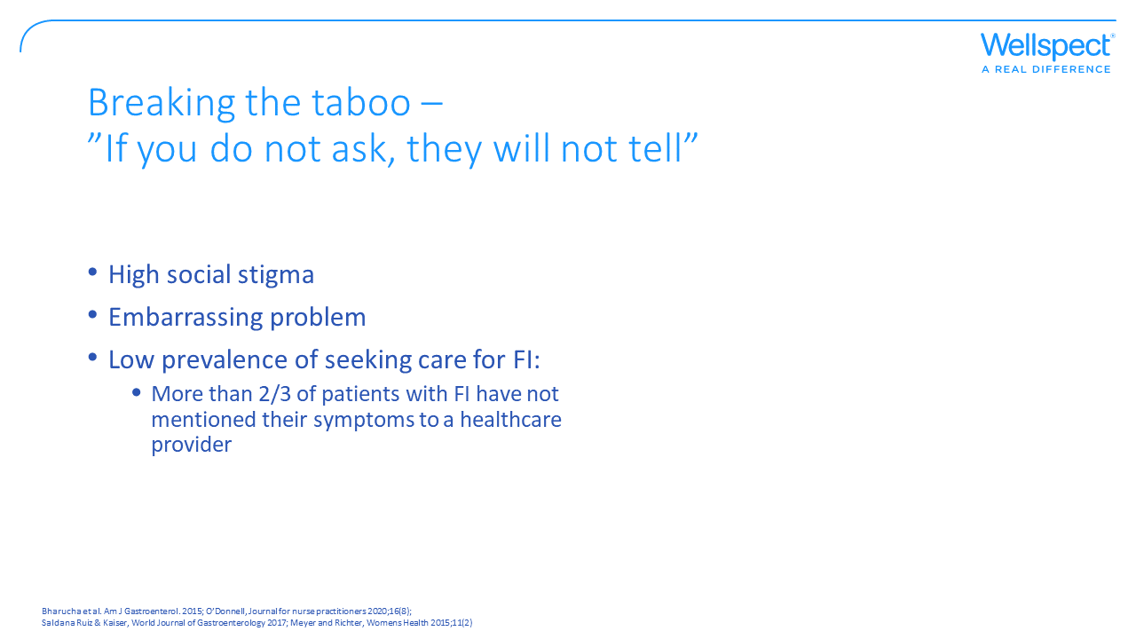
Notes:
Aim of slide: The most important way to manage FI is to start talking about it.
Information about altered bowel habits is an important first step in evaluating and treating fecal incontinence. Symptoms such as constipation and altered bowel habits are usually associated with FI, but patients often do not report the symptoms. To be able to manage FI, the symptom must be recognized. Less than a third of patients with FI have talked to any healthcare provider about their problems. This occurs because providers seldom screen for FI and patients do not voluntarily tell about their symptoms.

Slide 23
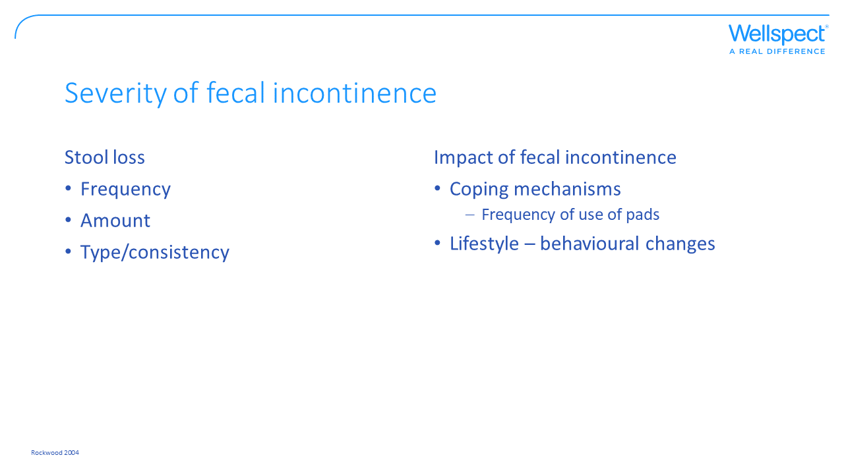
Notes:
Aim of slide: There are different degrees of fecal incontinence and it is important to assess the severity to manage the condition.
For assessing severity there are 2 primary domains that are considered and that is:
Stool loss – where the frequency of type and/or amount is assessed
Impact of fecal incontinence by the use of coping mechanisms such as use of pads and/or lifestyle-behavioral changes

Slide 24
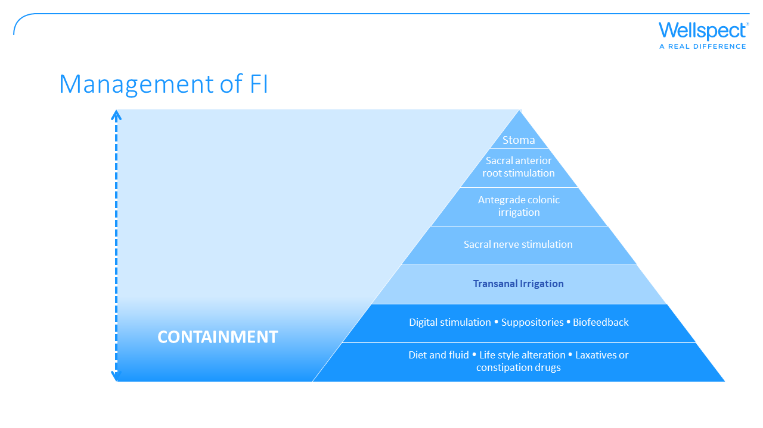
Notes:
Aim of slide: Management of FI is similar to other bowel dysfunction symptoms such as constipation apart from that containment may be needed.
The recommendation according to the literature is that treatment should be individualized beginning with conservative methods using a stepwise approach. The management of FI is generally starting with education, dietary modifications, skin care, and pharmacologic agents to modify stool delivery and consistency. Followed by pelvic floor muscle rehabilitation with biofeedback and rectal irrigation. These interventions will improve or resolve symptoms in 50% to 80% of patients.
If failed to improve symptoms, additional options include the use of a vaginal pessary, several minimally invasive procedures to the anal canal, neuromodulation, and more invasive surgical options, which improve symptoms in approximately 85% of patients. The goal of these procedures is to decrease FI episodes and improve quality of life for the patient. However, irrespective of the treatment, patients may not achieve complete continence and may need to continue using containment (O’Donnell, Journal for nurse practitioners 2020;16(8)).

Slide 25
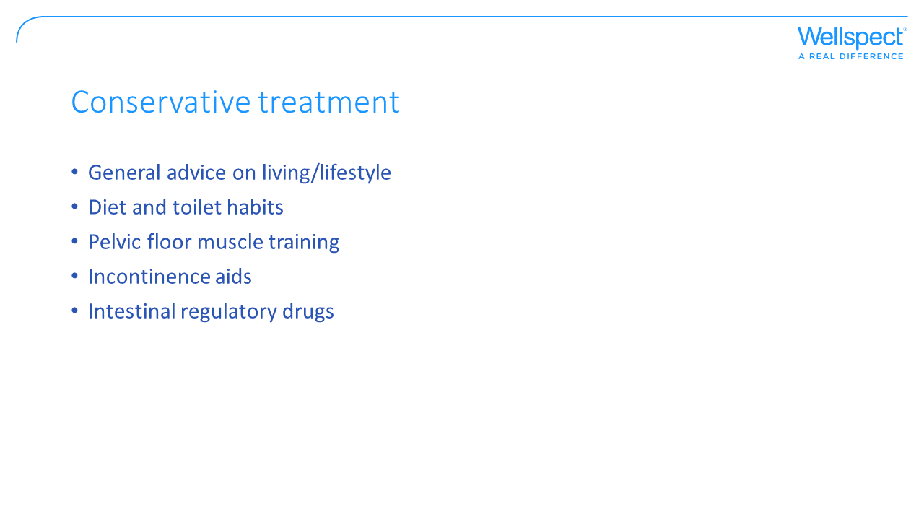
Notes:
Aim of slide: Describe conservative managment of FI.
Many patients are dependent on barrier protection to manage their bowel problems. Incontinence aids like anal/rectal inserts is a passive barrier to help prevent FI and it provides immediate results and could be a stand-alone therapy or be used in conjunction with other treatments such as biofeedback, dietary modifications, and/or the use of medications.

Slide 26
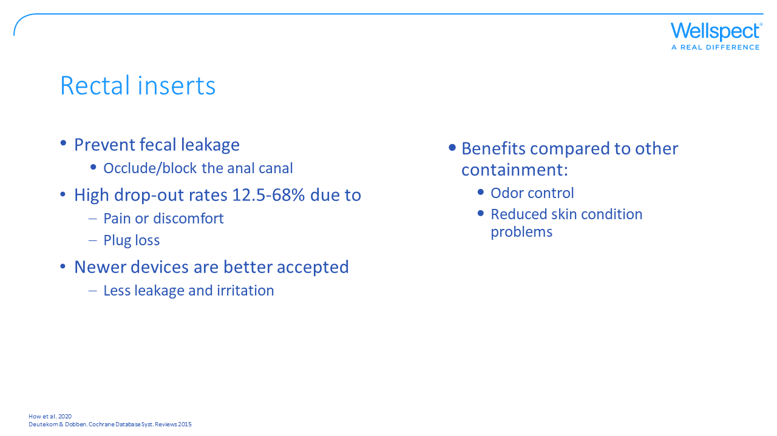
Notes:
Aim of slide: Function and benefits with a rectal insert as containment.
Rectal inserts/anal plugs are designed to temporarily occlude the anal canal to prevent stool leakage and can be used as a substitute for other forms of FI management such as incontinence pads, or as an adjunct to existing management regimens giving extra security.
The use of anal plugs is associated with poor tolerability due to discomfort and failure to retain the device. Therefore, several new rectal inserts has been developed that have taken into account the anatomy of the anal canal in the design to be more tolerable.
There are some reported problems with using pads as containment for fecal incontinence that is avoided with use of a rectal insert:
- Odour from the leakage is difficult to control
Extensive use of pads can result in skin condition problems.
Rectal inserts will be prescribed. The majority of patients with FI use self-help measures such as incontinence pads that do not require prescription and a visit to their healthcare provider.

Slide 27
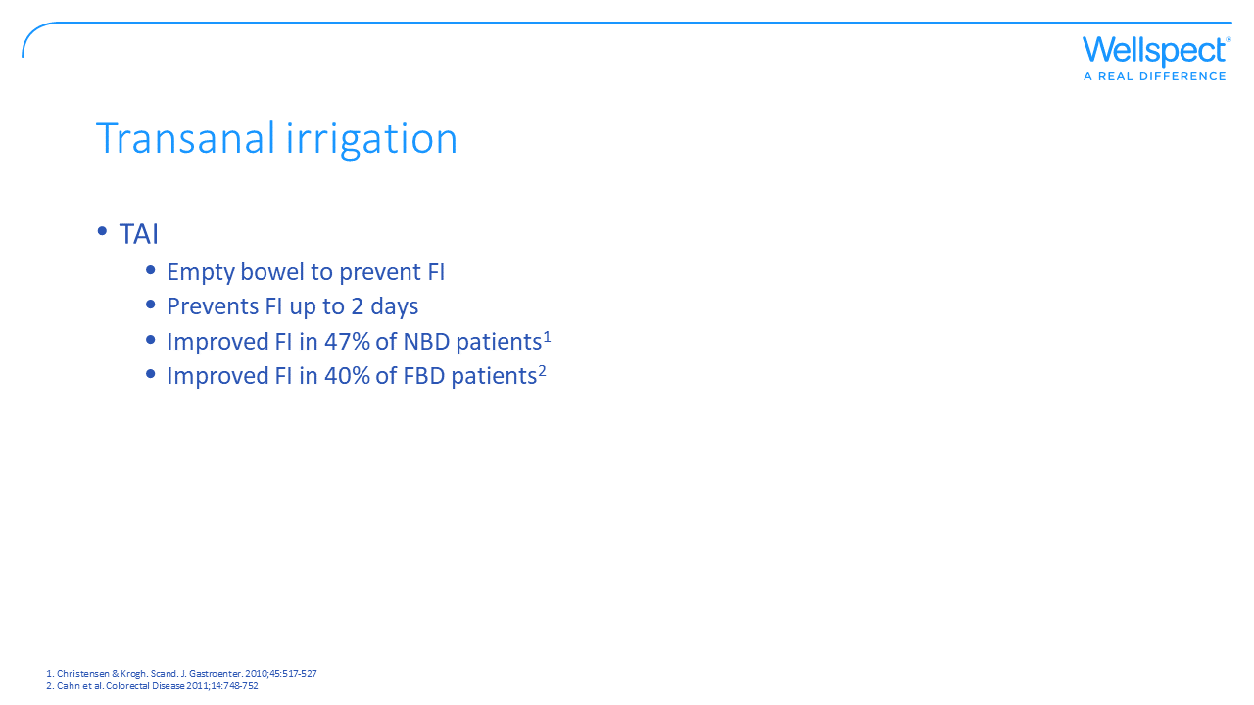
Notes:
Aim of slide: The efficacy of Transanal irrigation in management of FI.
Transanal irrigation is a method to prevent FI by instilling lukewarm water into the rectum and lower part of the colon to empty the bowel content. Depending on the volume of water used, the bowel will be emptied in a way that prevents FI for up to 2 days. In a review of 17 studies including in total 1229 subjects FI was improved in 47% of the subjects with NBD when using TAI (Christensen & Krogh. Scand. J. Gastroenter. 2010;45:517-527 ).

Slide 28
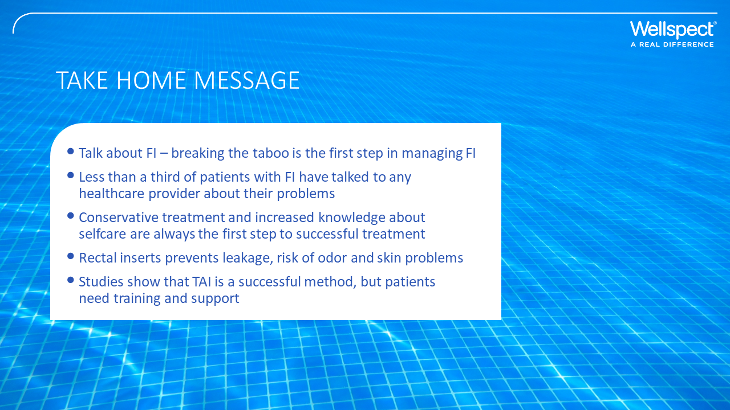

Slide 29
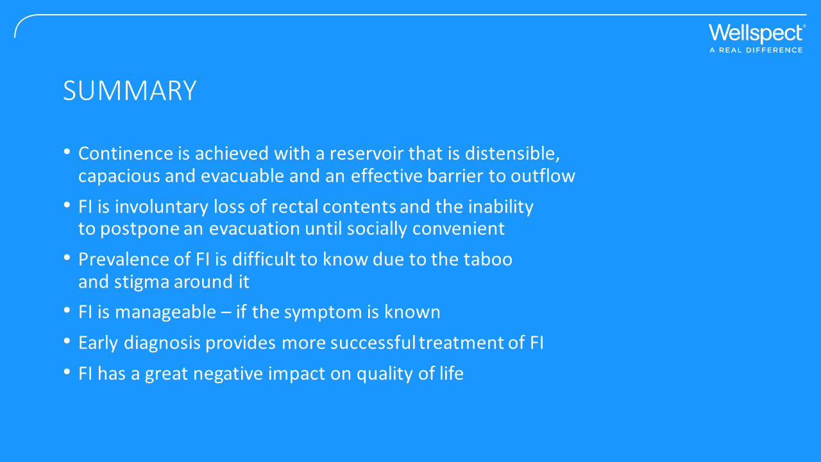

Slide 30
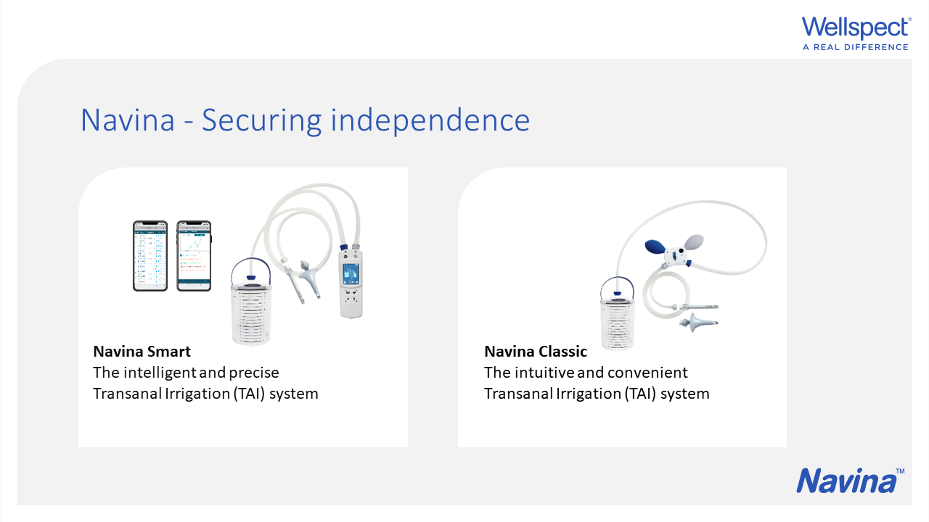

Slide 31


Slide 32
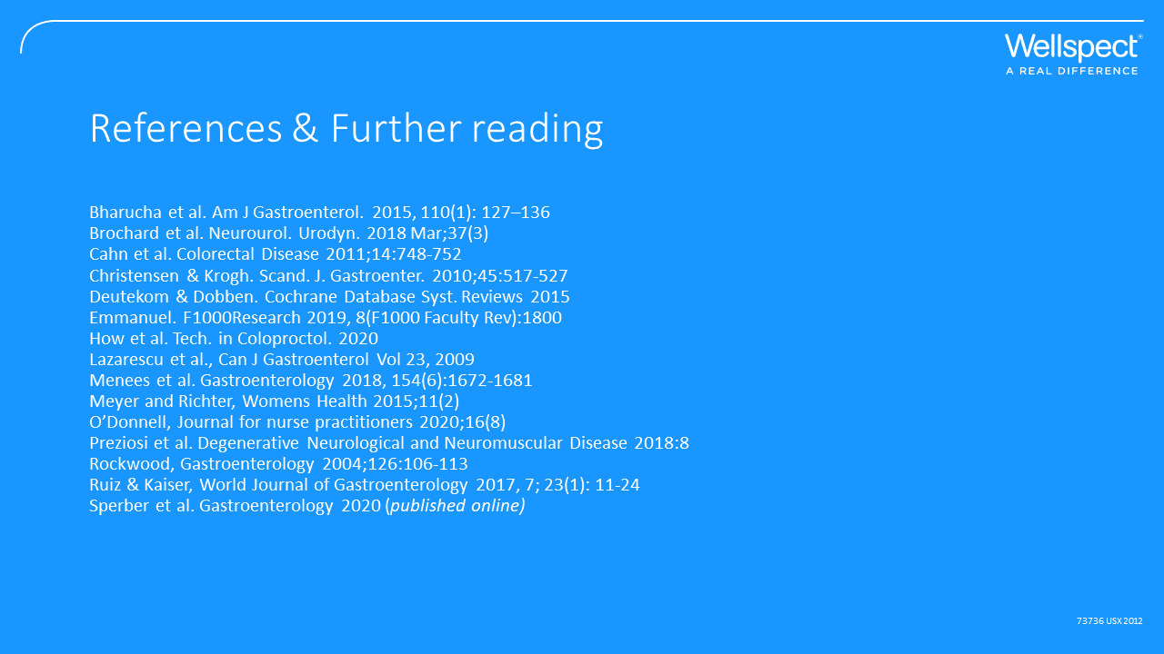

Slide 33


