Slide 1



Slide 2
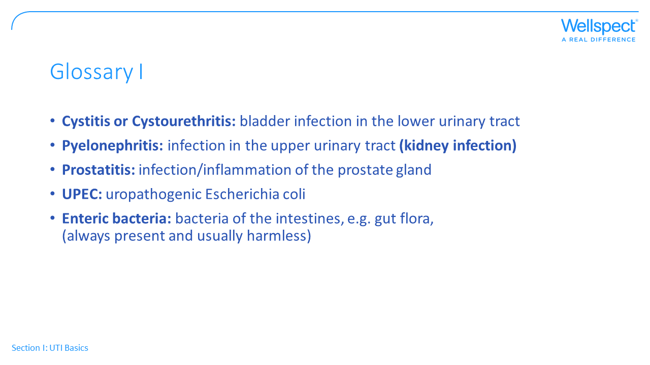
Notes:
A few slides are put together with vocabularly often used both when reading articles and in discussions with HCPs.

Slide 3
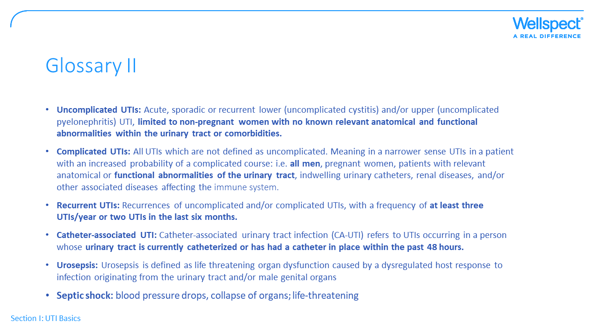
Notes:
The commonly used vocabulary when talking with a HCP is listed here for convenience

Slide 4
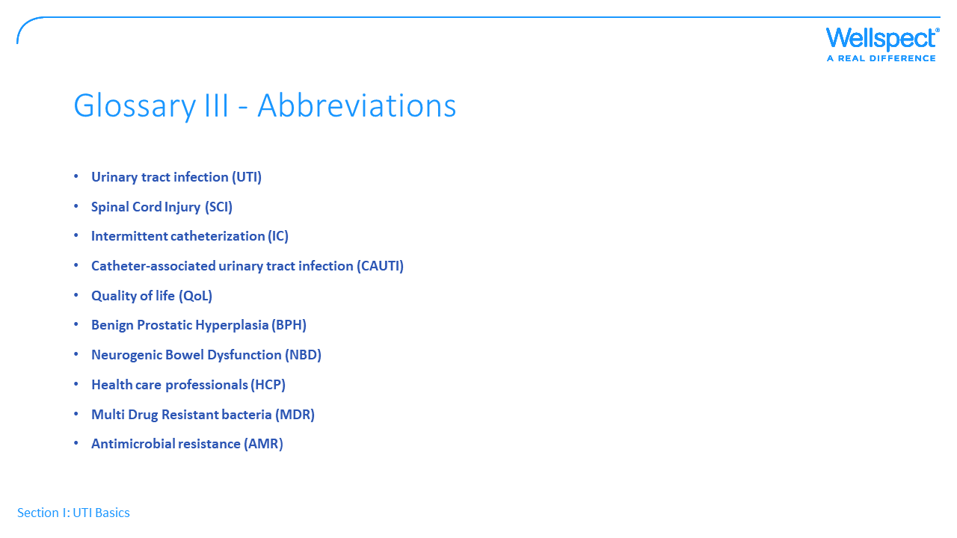
Notes:
The commonly used vocabulary when talking with a HCP is listed here for convenience

Slide 5
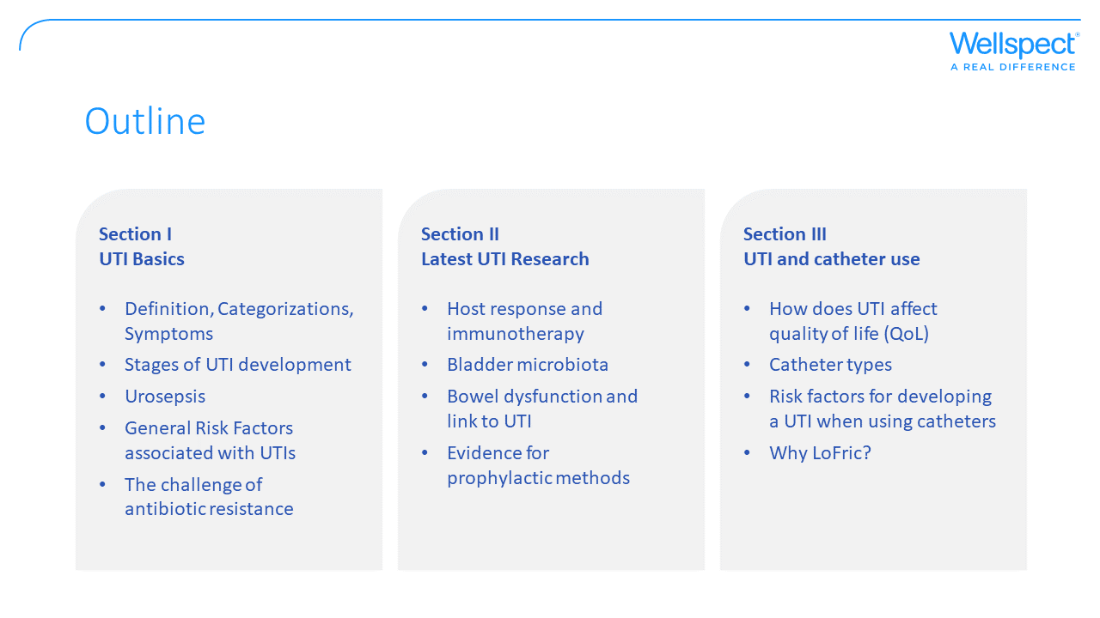
Notes:
The presentation was built in 3 sections:
The first is something that I think can be useful for everyone working at Wellspect at Sales and marketing, maybe used for new employees.
Section II is to show what is out there in the literature and the focus in many conferences, but parts of this can be controversial and not everyone will agree. You pick what you like.
Part III is the link to LoFric

Slide 6


Slide 7
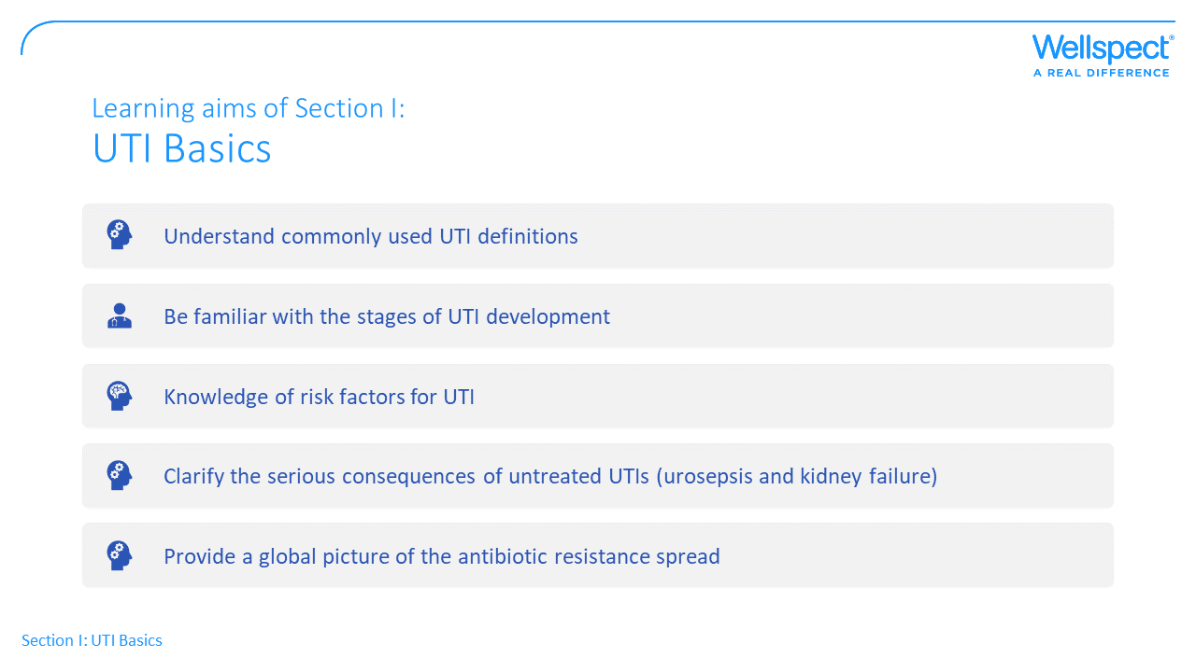

Slide 8
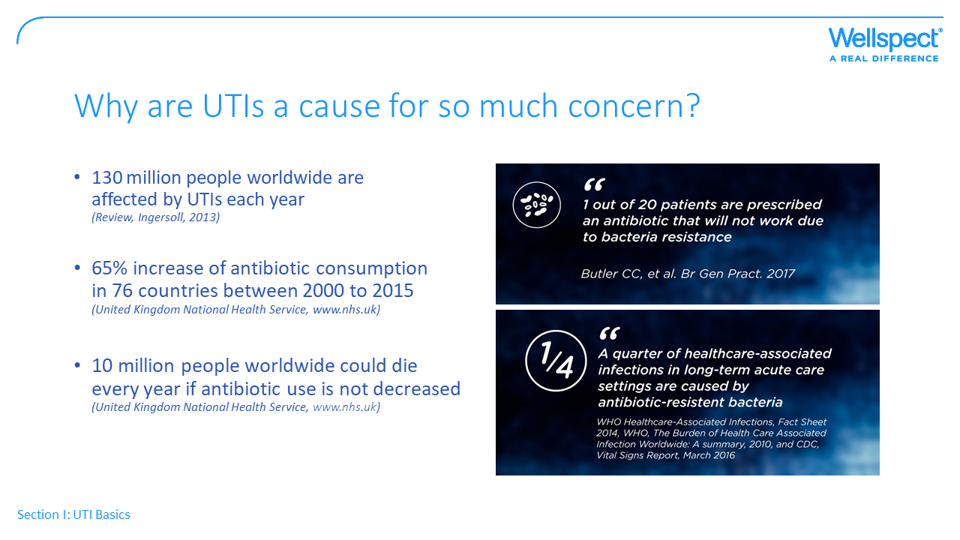
Notes:
UTIs are the most common bacterial human infections and account for a lot of the prescribed antibiotics for treatment. Each year more than 130 million people worldwide are affected by a UTI (the numbers refer to both uncomplicated and complicated UTIs), with very high health costs.
One of the main health web sites in UK has reported a 65% increase of antibiotic consumption in the past 20 years among several countries. This is the general antibiotic consumption for all infections, not only UTI, but UTI is a significant part of it.
On this website experts estimate that about 10 million people are at risk of dying from infections if antibiotic use is not decreased.

Slide 9
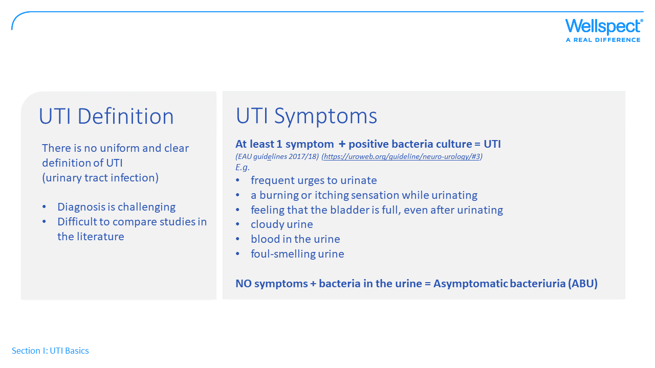
Notes:
There is no uniform and clear definition of UTI. Which makes it difficult to follow-up and compare between studies. A variety of suggestions are available of what concentration of bacteria in the urine is relevant to measure and there is no exact answer to this. Many patients are prescribed antibiotics over the phone and many are treated without a urine culture.
In the different UTI definitions we can often read: “a significant bacteriuria in persons performing IC is present with > 10² cfu/mL, > 10⁴ cfu/mL”
The concentration may be of less importance and what really matters is the symptoms together with positive bacteria culture. Bacteria in the urine doesn’t cause harm, the problem occurs when they attach to the cells in the bladder and the body reacts with fever etc.

Slide 10
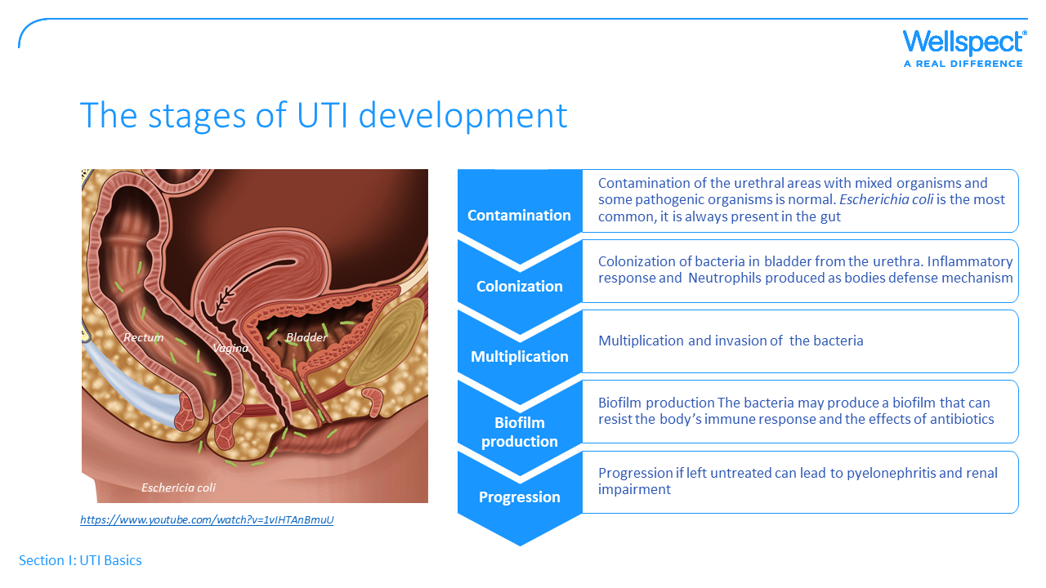
Notes:
UTIs occur as a result of interactions between the uropathogen and host and involves several processes.
E.Coli is present in the human body, a lot in the gut normally contamination of the urethral areas is not a problem since the flush of urine will wash them out when emptying the bladder. But when this does not work, for example in patients using catheters the bacteria will move along the urethra into the bladder, attach to the bladder wall, multiply and cause tissue damage. The body will react with fever and other symptoms.
Sometimes the bacteria form a biofilm which is when they stick to a surface and together form a hard structure known as biofilm. This makes it much harder to defeat the bacteria since they are sort of protected from the antibiotic treatment.
The human body has a first line of defense with cells lining the lumen of the bladder preventing bacteria to attach. If bacteria bypass this first line of defenses and if the immune system fails, a UTI can occur
The bacteria have specific weapons called virulence factors on their surface, functioning like arms to grab on to the bladder wall. When developing new treatments against bacteria this is often the focus, “cutting the legs” and making the bacteria not being able to attach.
If left untreated UTI may lead to severe infections of the kidneys

Slide 11
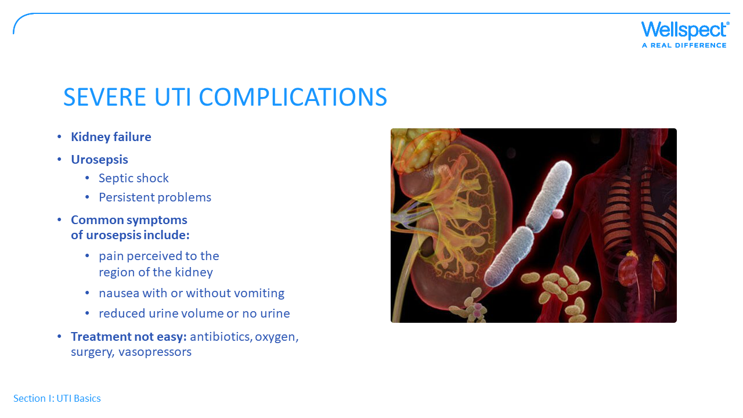
Notes:
There are two major complications of UTIs, they are usually associated to indwelling catheters.
The first is infection spread to one or both kidneys. If the infection continues, kidney function can be damaged and result in kidney failure or complete loss of kidney function.
The second complication is that the bacteria enter the bloodstream and may infect other organs. It could potentially cause sepsis and death.
In some serious cases, urosepsis may progress to severe sepsis, septic shock, or multi-organ failure. Patients with severe sepsis produce little or no urine, they may have difficulty breathing and effect on the heart. The blood pressure drops to extremely low levels, no oxygen to the organs which may eventually shut down. These symptoms are life-threatening and require immediate medical attention.
However, treating urosepsis is not as simple, because it may not respond to antibiotics alone. A doctor will likely start the treatment with antibiotics because it is essential to treat the bacteria that caused the original UTI. They may also require oxygen, intravenous fluids and some people will need surgery to get rid of the source of an untreated infection completely.
Problems can remain for long time also after recovery from the acute phase.

Slide 12
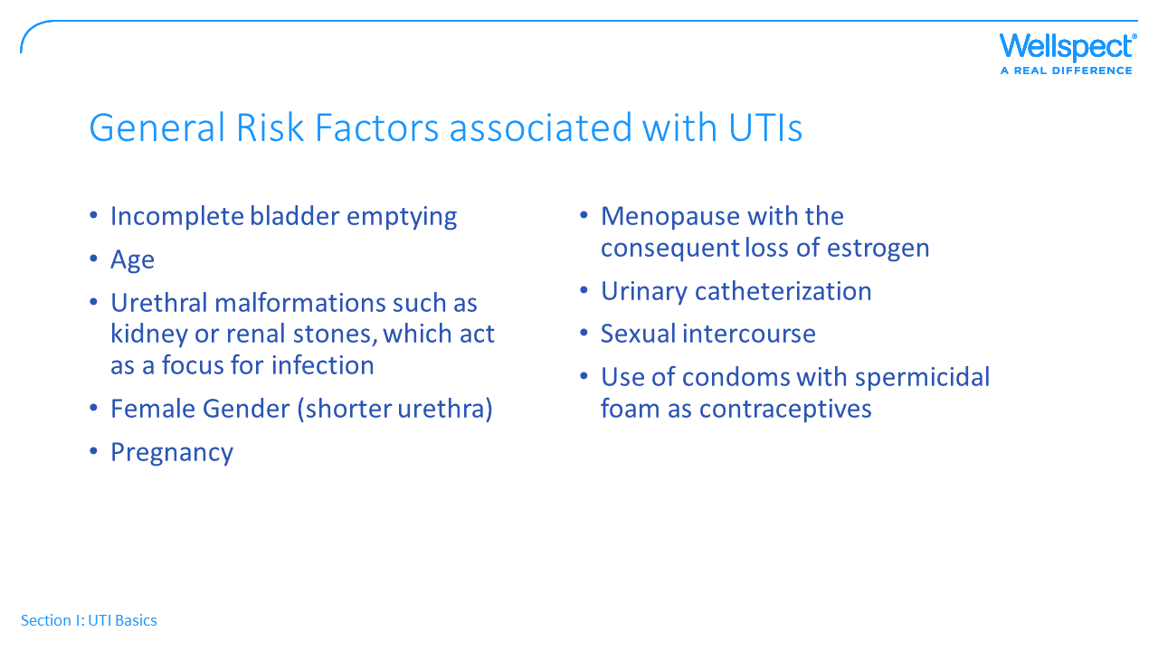

Slide 13
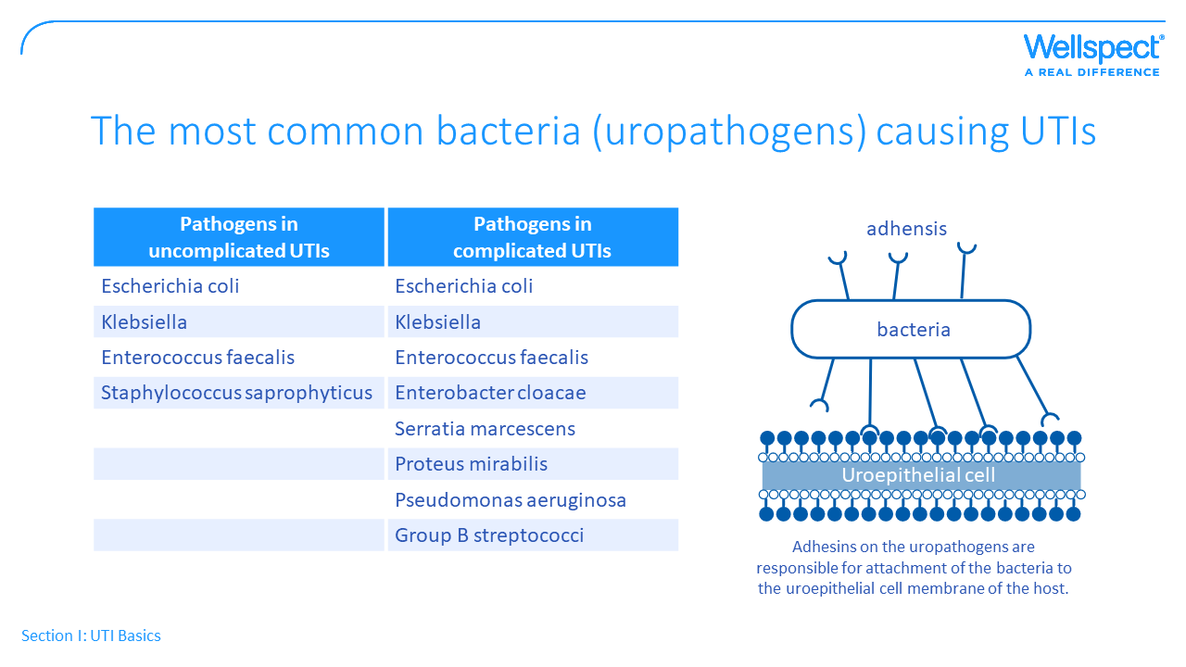
Notes:
E. coli is the bacteria that most frequently cause UTIs.
Bacterial have something called “virulence factors” and this play a significant role in determining if the bacteria will invade the urinary tract and the level of infection.
Uropathogenic E. coli are present within the bowel and by expressing specific virulence factors that permit the bacteria to attach to the bladder surface and multipy in the lower urinary tract, they cause harm. Other common bacteria to cause UTIs are Klebsiella, Enterococcus faefacalis and Proteus.

Slide 14
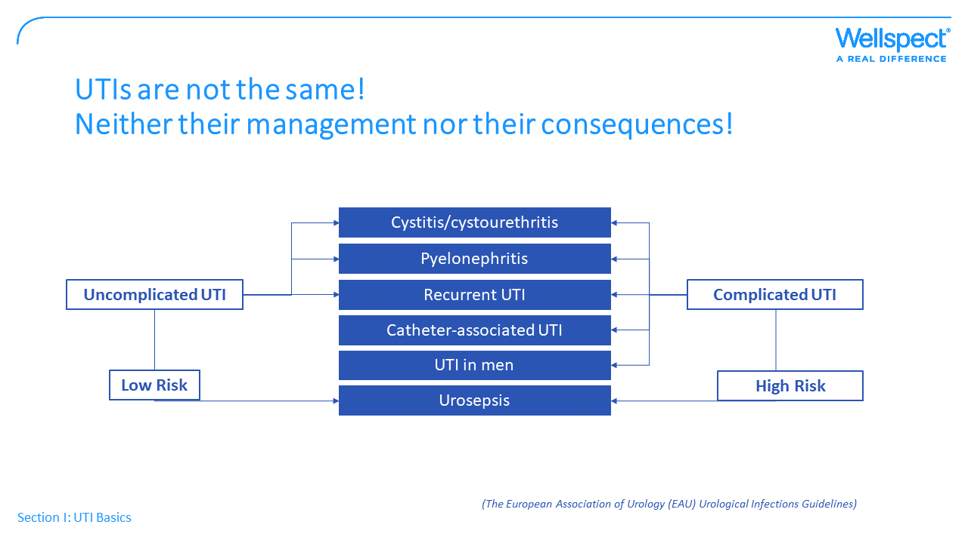
Notes:
UTIs can be classified as either complicated or uncomplicated depending on underlying factors at the affected patient and the type of bacteria causing the infection.
The definition by EAU is the following:
Uncomplicated UTIs mainly refer to the UTIs occuring in otherwise healthy women. It can cause infection in both the lower urinart tract (cystitis) and upper urinary tract affecting the kidneys. It may result in recurrent UTIs. However the risk of complications such as urosepsis is low.
Males are less prone to receive UTIs bacuse of the longer urethra, and when it happens they are classified as Complicated according to EAU guidlines.
Catheter users suffering from a UTI are also classified as Complicated and have higher risk of complications.
Definition:
Uncomplicated (no concomitant disease that would promote the UTI)
Complicated UTI (patient with a structural or functional abnormality of the genitourinary tract)
Urinary tract infections in patients performing intermittent catheterisation for bladder dysfunction are classified as complicated UTIs and it’s the scope for this material.

Slide 15
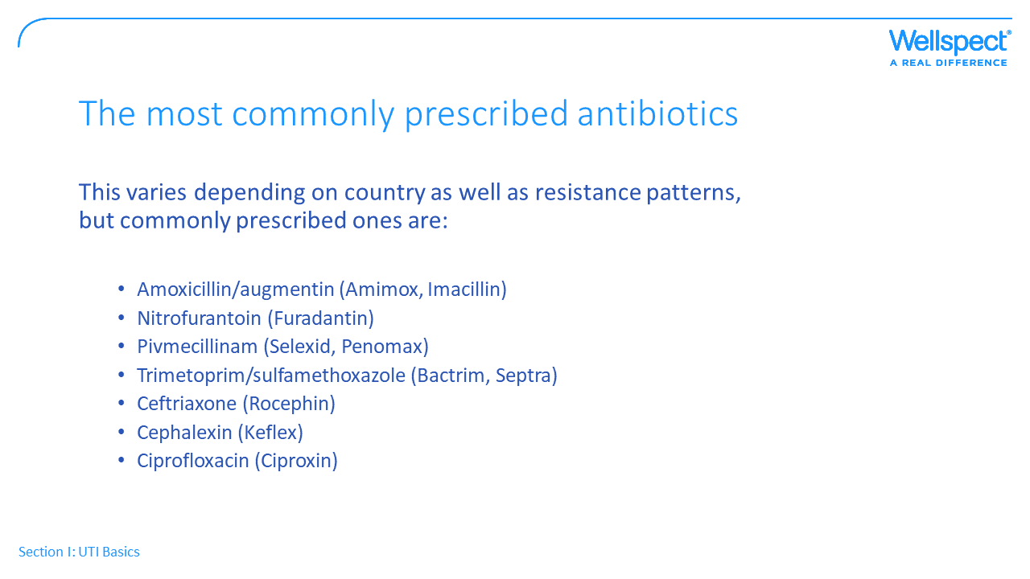
Notes:
At a suspected UTI the medical doctor will provide the lab with the urinary sample and they will grow the germs in a dish for a couple of days to find out
-which type of bacteria that cause the infection
and ideally also which type of antibiotics is optimal.
The doctor will most likely prescribe one of the following antibiotics to treat the infections already before receiving the results from the bacteria culture.
We already touched upon the major issue with the increase in antibiotic resistance

Slide 16
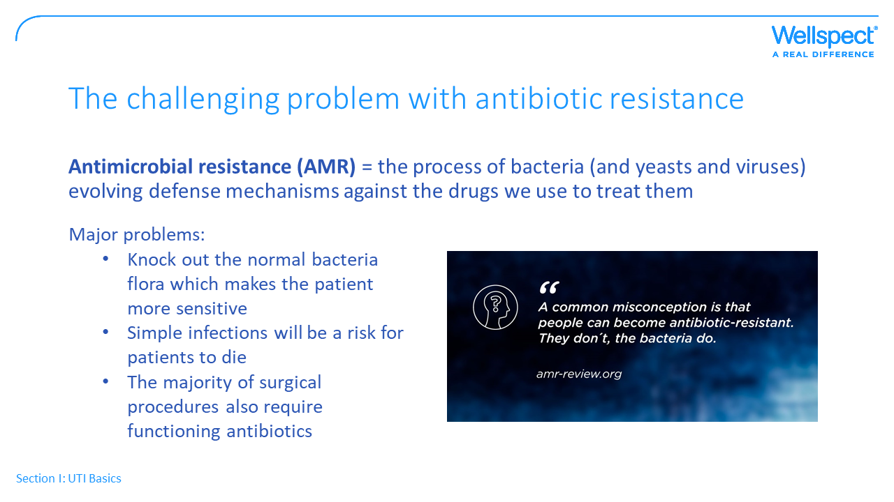
Notes:
Antibiotic use make the bacteria adapt and develop new ways to avoid the effects of antibiotics. Once new resistance develops, exposure to antibiotics wipes out susceptible bacteria and allows the resistant ones to survive and multiply. The surviving bacteria have resistance traits in their DNA and this genetic information can pass from generation to generation, move between germs creating more resistant ones, and continue to spread.
Resistance to even one antibiotic can mean serious problems. Antibiotic-resistant infections that require the use of second and third-line treatments harm patients and prolong care and recovery, sometimes for months. Healthcare providers may need to treat these infections with antibiotics that have serious side effects (such as organ failure)

Slide 17
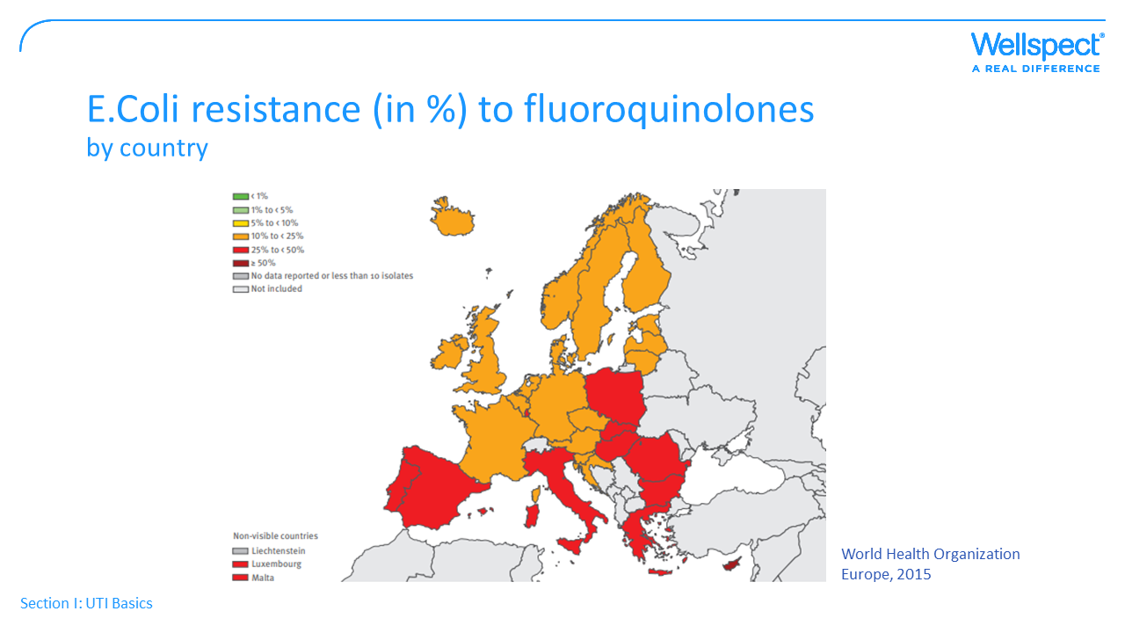
Notes:
High levels of resistance to many commonly prescribed antibiotics have been identified worldwide. This slide shows E.Coli resistance (in %) to fluoroquinolones among countries in Europe, (e.g the medication Ciprofloxacin belongs to this group). Fluorokinoquinolones hasve high activity against E. coli, Enterobacter
spp., Klebsiella. Also on P. aeruginosa. Not so efficient against enterococci and staphylococci.
The countries marked in red has up to 50% resistance according to the World Health organization, and these numbers are a few years old.
In some countries in Africa the resistance to Amoxicillin is now 100% among urinary isolates of E. coli in some countries in Africa, and high levels of resistance to many commonly prescribed antibiotics have been identified worldwide.

Slide 18
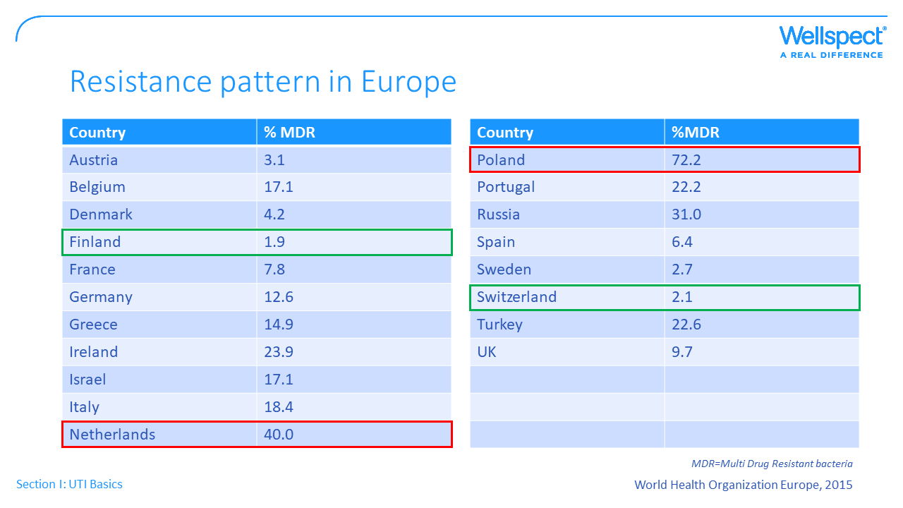
Notes:
In countries with a less controlled antibiotic prescription it’ s clear that they suffer from Multi-drug resistance meaning several antibiotics will be useless in treating a UTI caused by e.g E. coli.
WHO show numbers around 2% MDR in Finland and Switzerland, a little higher in Sweden (2.7) whereas the numbers are 40% in the Netherlands and 72%(!) in Poland.
To stop this trend bacteria cultures should always be taken directly in order to provide the optimal antibiotic right from the start, when needed.
It’s important for us to know that this huge problem is not something far away it’s already here. The challenge is:
Sensitive patient groups like catheter users are at risk if waiting a few days for bacteria culture before starting treatment
on the other hand this over-treatment (I think it’s fair to use this word) will result in people dying from infections when the antibiotics are no longer useful

Slide 19
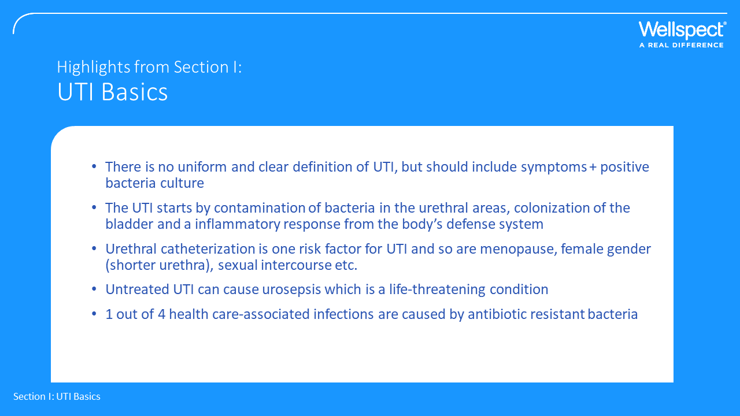

Slide 20


Slide 21
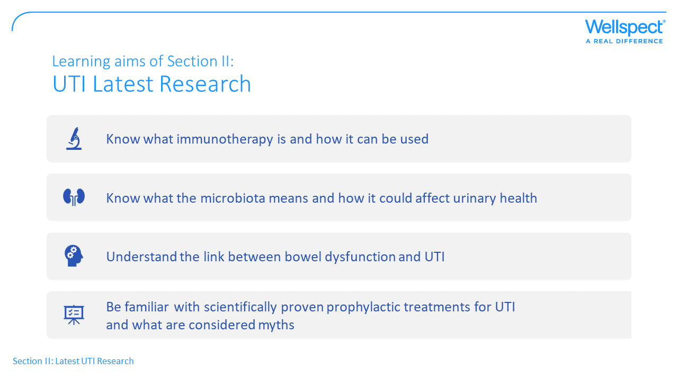
Notes:
This material comes from screening of the recently published scientific literature (past 5 years)

Slide 22
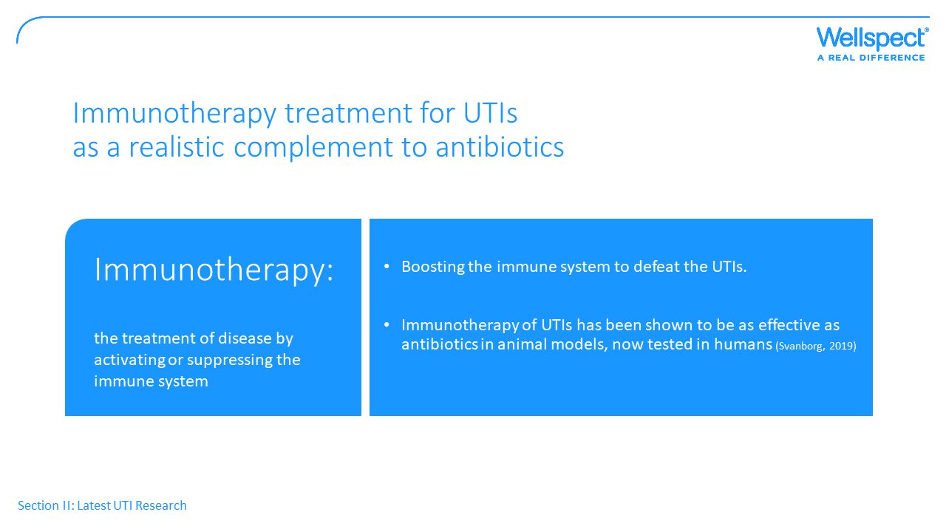
Notes:
Alternative ways of treating infections are urgently needed due to the alarming increase with antibiotic resistance. The research in this area is focused on finding therapeutic options that circumvent the need for antibiotics while boosting the human’s own immune response.
This is based on the fact that the severity of the UTI reflects how good the immune system is in the affected person.
The innate immune system plays a fundamental role in protecting the urinary tract from infections. An important part of this inherited immunity is the presence of antimicrobial peptides. They are produced by the cells in our body called neutrophils, acting as the first-line defense against enemies and defend the urinary tract against invading bacteria.
Much effort has been put into exploring the role of these natural occurring guards in the body and possibilities to utilize them in clinical practice.
Catharina Svanborg is a Swedish researcher at University of Lund who will be a speaker at ACCT in April. She has really interesting research on-going where she has seen in animal models that boosting the body’s immune response is just as effective as antibiotics in treating a UTI. This is now tested in humans with the goal to also provide long-lasting immunity for recurrent UTIs.

Slide 23
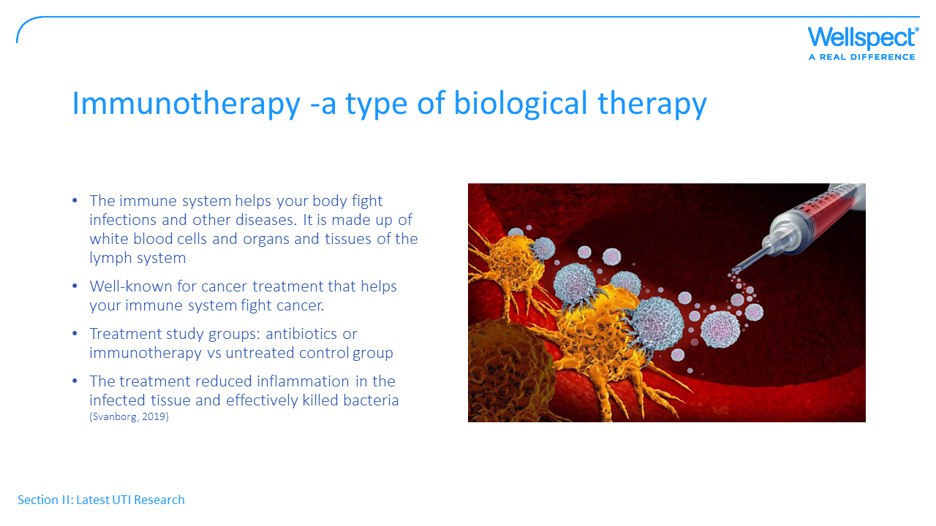
Notes:
This concept is based on new knowledge about how the immune system works in detail, to strengthen the defensive aspects and block the damaging aspects of the immune response.
In their animal study they had three groups: in the first the UTI was treated with antibiotics, second with immunotherapy and the third untreated as control group. The data indicated that the immunotherapy treatment produced a healing response in the infection that was entirely comparable with antibiotics. The treatment reduced inflammation in the infected tissue and effectively killed bacteria. They have started clinical treatment studies, primarily focused on recurring urinary tract infections.

Slide 24
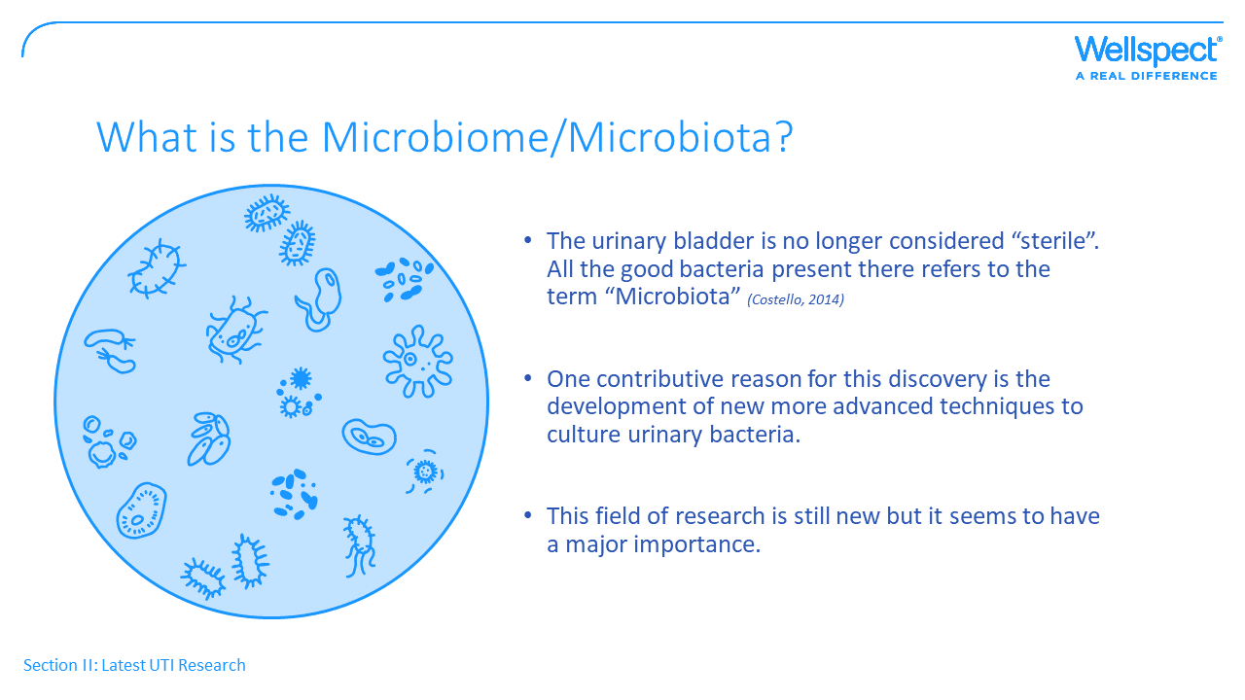
Notes:
Sometimes used interchangeably, these two terms have subtle differences:
Microbiota: all the microorganisms found in an environment, including bacteria, viruses, and fungi.
Microbiome: individual to each organism; the diversity in microbiomes between individuals is huge. A unique microbiome for each human
The traditional view of urine sterility has been challenged by the discovery of the urinary microbiome, meaning a mix of bacteria and microorganisms within the urinary tract, just as is known since long time in the bowel.
Several studies suggest that the urinary microbiome may play a role in several diseases of the urinary system, such as urge incontinence, bladder cancer, and overactive bladder.
Along with technical development there are now more sensitive and advanced methods to culture and detect bacteria in the urinary tract. This filed is still new but it clearly indicates the important role of the microbiome in urinary health and disease.
Vikram Khullar from UK will be the speaker of this field at ACCT.

Slide 25
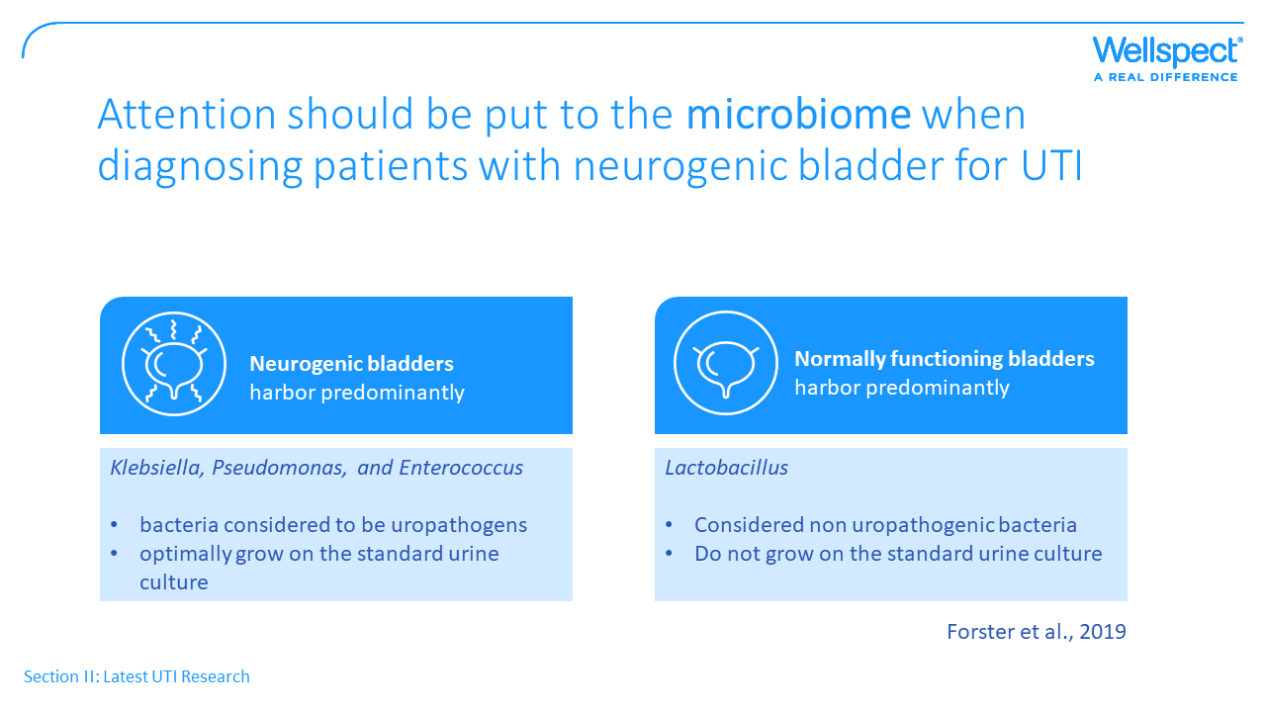
Notes:
A recent American study on patients with neurogenic bladders these patients were shown to have other types of bacteria in the urine compared to people with normally functioning bladders. Bacteria considered to be uropathogens such as Klebsiella, Pseudomonas, and Enterococcus were often found in these patients whereas Lactobacillus were common in the control group. The uropathogens grow very well on the standard urine culture whereas Lactobacillus of course does not.
The authors state that this partly explains the high levels of asymptomatic bacteriuri (ABU) in people with neurogenic bladders, that this is a non-specific term and the importance of accurately diagnosing UTIs in these patients to avoid overuse of antibiotics. A direct correlation have been shown in studies between antimicrobial treatment of asymptomatic bacteriuria and the presence of multidrug-resistant organisms in the urine. (Forster 2019)

Slide 26
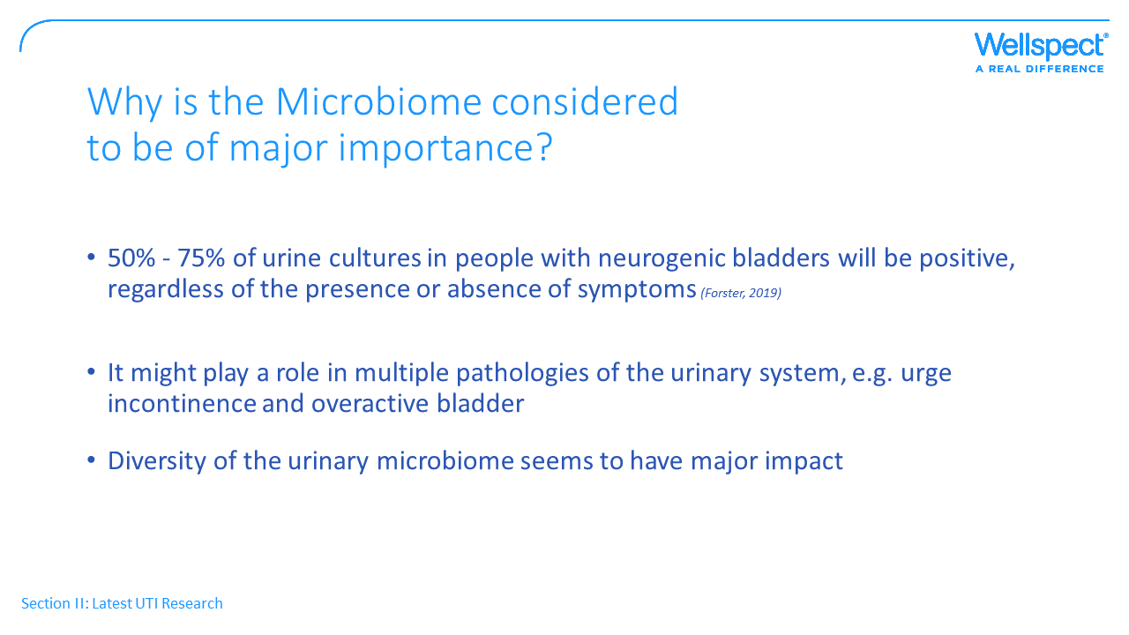
Notes:
The same authors showed in their study that 50% - 75% of urine cultures in people with neurogenic bladders were positive, regardless of the presence or absence of symptoms. They say there are several problems with the definition of UTI commonly used since people with neurogenic bladders have differing physiologies. There are more articles in this field where the authors state a need for diagnosing UTIs in people with neurogenic bladders in more accurate ways because of their diversity.
One major thing that is observed in several papers is that a diversity, a mix of microorganisms in the urinary tract, is key to avoid developing UTIs.

Slide 27
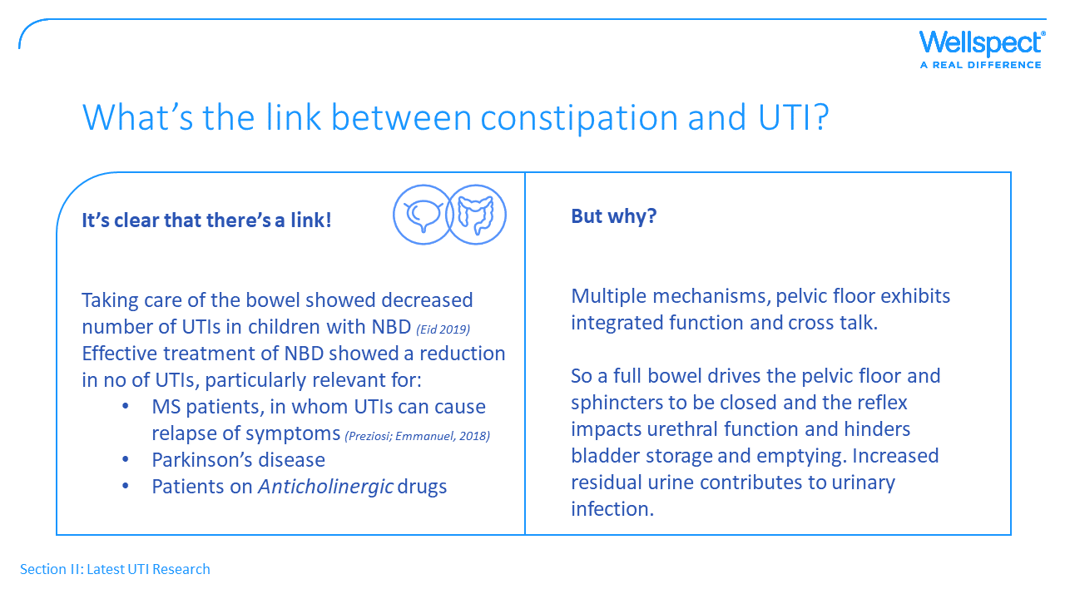
Notes:
The third area within the research block is the link to the bowel:
A combined bladder and bowel concept is something we have communicated at Wellspect for quite some time now. And it’s clear there’s a link, the close proximity of the bladder and bowel cause functional interactions.
Still there is not much research done in this field, but there are evidence e.g from studies on children with neurogenic bladder dysfunction showing a reduced number of UTI’s during the following year after treatment with bowel management. This is an area Niall Galloway from US will present at ACCT, and he says that data on children can also be extrapolated to adults and other patient groups. An that this can be particularly relevant for:
MS patients, in whom UTIs can cause relapse of symptoms (Preziosi; Emmanuel, 2018)
Patients on Anticholinergic drugs (to treat a variety of conditions, including bladder conditions), the side effects are many e.g constipation
The exact reason why constipation is associated with UTIs is not yet fully understood, but the opinion from most experts is that an overloaded rectum with stools will compress on the bladder, which decreases bladder capacity and this can lead to incomplete bladder emptying and this residual urine is an increased UTI risk.

Slide 28
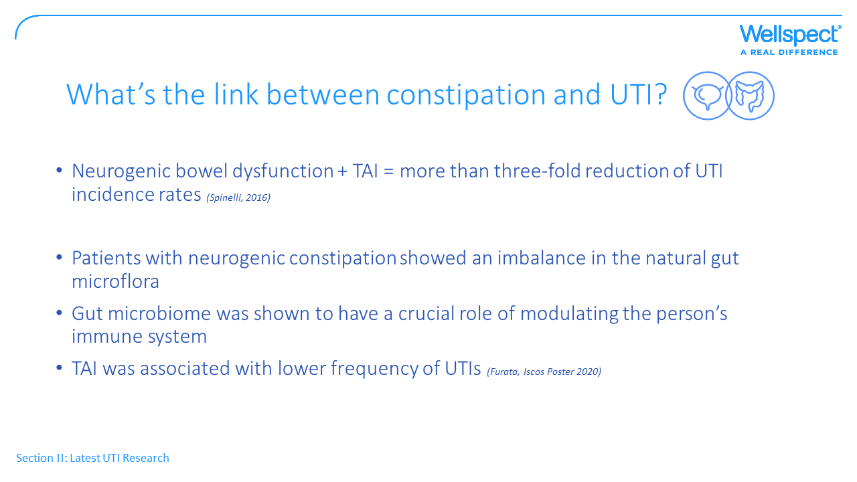
Notes:
At Iscos 2020 Dr. Krassioukov described how distal colon and urinary bladder have similar function, joint innervation etc. and it’s therefore not unexpected that spinal cord injuries also affect colorectal motility, transit times, and bowel emptying. In a study of patients with neurogenic bowel dysfunction treated with transanal irrigation, a more than three-fold reduction of UTI incidence rates was documented compared to the control group.
There was also a Japanese group at iscos 2020 presenting some interesting figures. In the study they included patients with spina bifida and SCI suffering from constipated. They analyzed changes in gut microbiota before and after TAI. They found that:
-patients with neurogenic constipation showed an imbalance in the natural gut microflora
- The gut microbiome was shown to have a crucial role of modulating the person’s immune system
- Patients using TAI had lower frequencies of UTIs.

Slide 29
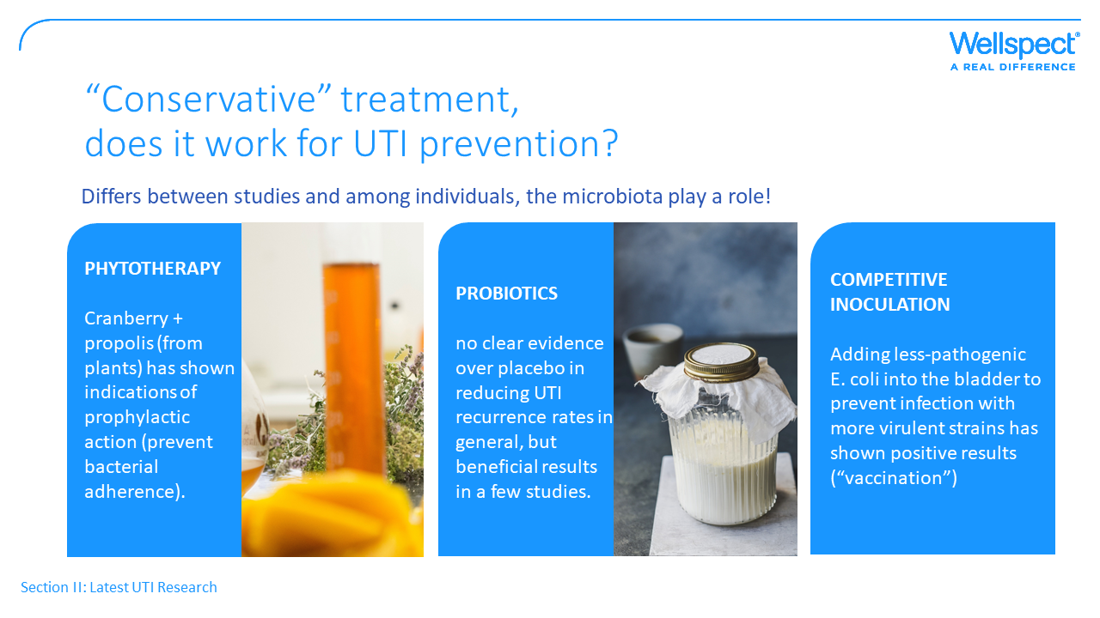
Notes:
The last part of the research section relates to if there are scientific evidence for effective prophylaxis against UTI.
Phytotherapy (extracts of natural origin)
You remember the picture of bacteria with arms to attach to a surface. This ability to adhere to epithelial cells in the urinary tract of the host is the most important feature that should be hindered. Propolis is material collected by honeybees from tree buds (“bee glue”) and this has shown to have an effect to prevent bacterial adherence. So, there are scientific evidence for prophylactic action if a combination of cranberry and propolis are used.
Probiotics
There are studies showing beneficial results, but in a recent review that was thoroughly done, of seven randomized controlled trials, they concluded that probiotics have no benefit over placebo in reducing UTI recurrence rates.
Competitive inoculation
This is sort of a vaccination and means instillation of less-pathogenic E. coli into the bladder. The idea is to prevent infection with more virulent strains and studied have shown promising results in patients with indwelling catheters and incomplete bladder emptying, but this method needs further investigation in larger trials to show more evidence of UTI prevention.
So these three ways of trying to prevent UTIs can be called conservative methods and if they have a scientifically proven effect differs very much between studies. It seems like the individual’s immune system play a major role. The differences in the microbiome among individuals differs and so does the effect of treatments.

Slide 30
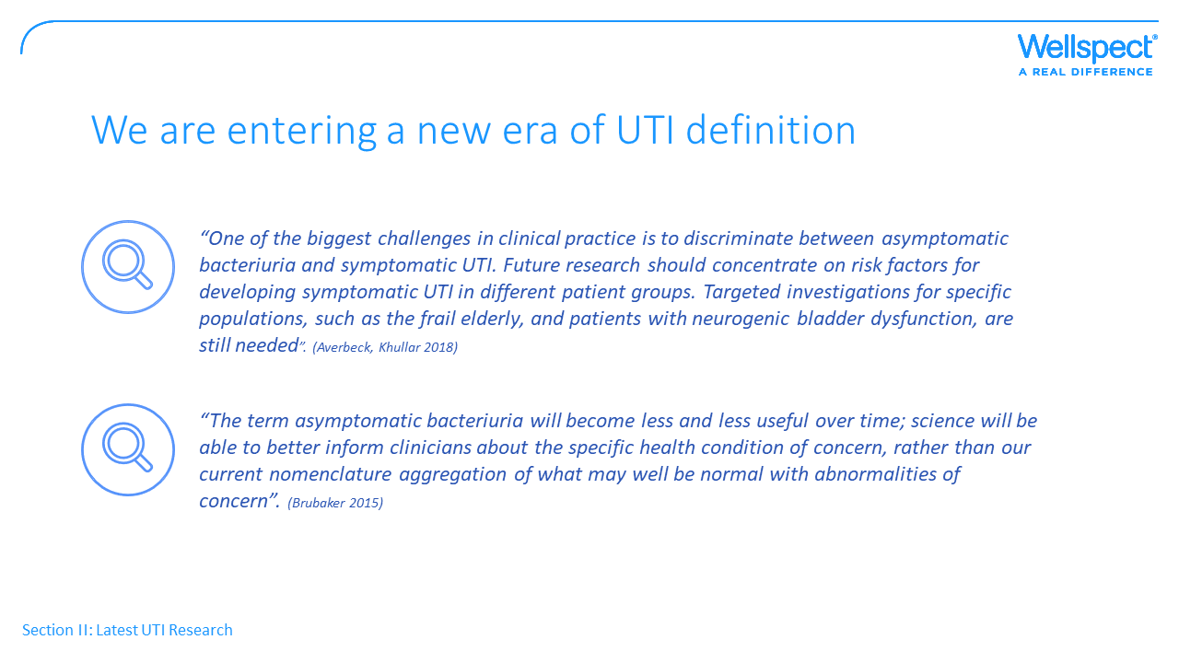
Notes:
Almost every new article writing about UTIs starts with the major problem that we lack a uniform and common definition of UTI’s. It is important to have a consensus about how UTIs should be defined in order to interpret studies and compare and get use of the results. UTI-symptoms in SCI-patients are difficult, and may sometimes be vague.
Here are two quotes that are representative for the expert opinions.
Linda Brubaker is a leading researcher within the field of microbiota, from the US. She declares that the term ABU needs to be revized and may be less useful over time since the urinary tract involves a lot of bacteria (you have heared about the microbiota) and patients with neurogenic bladder will have a lot of bacteria without for that cause having a UTI. The concentrations of bacteria can not be looked at alone.
Epidemiologic studies have convincingly shown that in most cases, ABU is harmless and that bacteriuria may protect against infection with more virulent strains. Several researchers mean that it is now widely accepted that ABU is beneficial and should be left untreated (Svanborg).
Would be interesting to know your opinion on this.

Slide 31
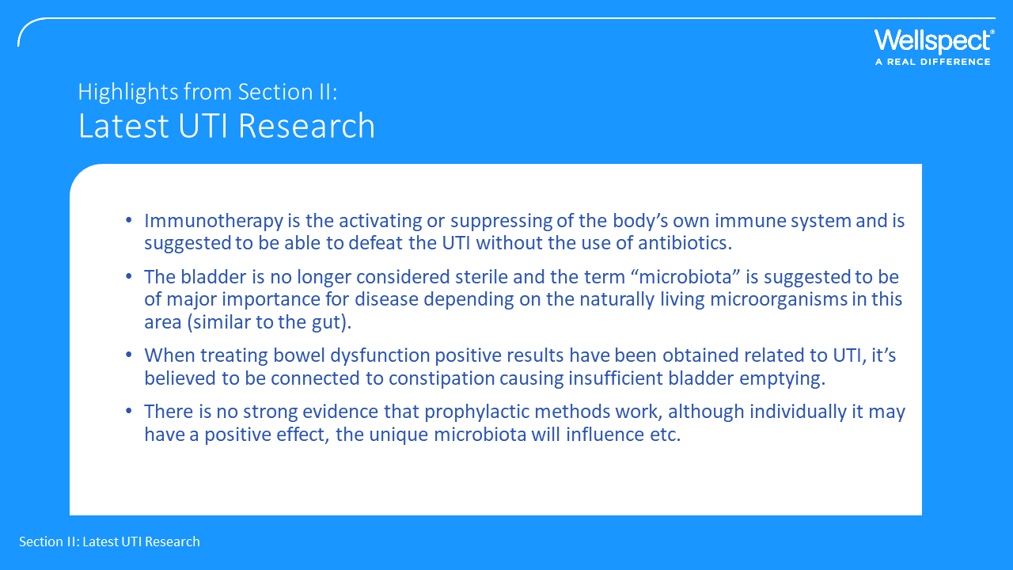
Notes:
Immunotherapy is treatment that uses certain parts of a person's immune system to fight UTIs without the need for antibiotics. So, by boosting the natural defenses of your immune system it works harder or smarter.
The bladder is no longer considered sterile and the bacteria present in the urinary tract are referred to as the Urinary Microbiota, suggested to be of major importance for health and disease.
Constipation seems to cause insufficient bladder emptying and by bowel management you can decrease the number of UTIs affecting a patient.
In some individual’s prophylactic methods against UTI will surely work, it will depend on this patients’ microbiota, immune system and other factors, but there is no strong scientific evidence for this yet available.

Slide 32


Slide 33
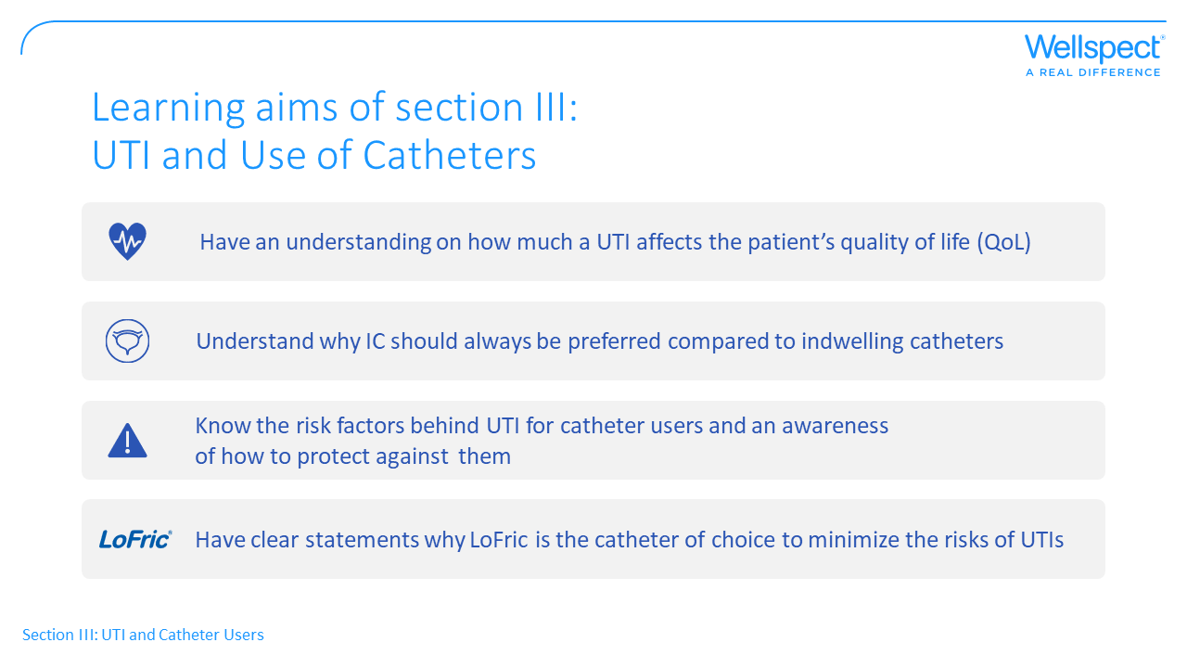

Slide 34
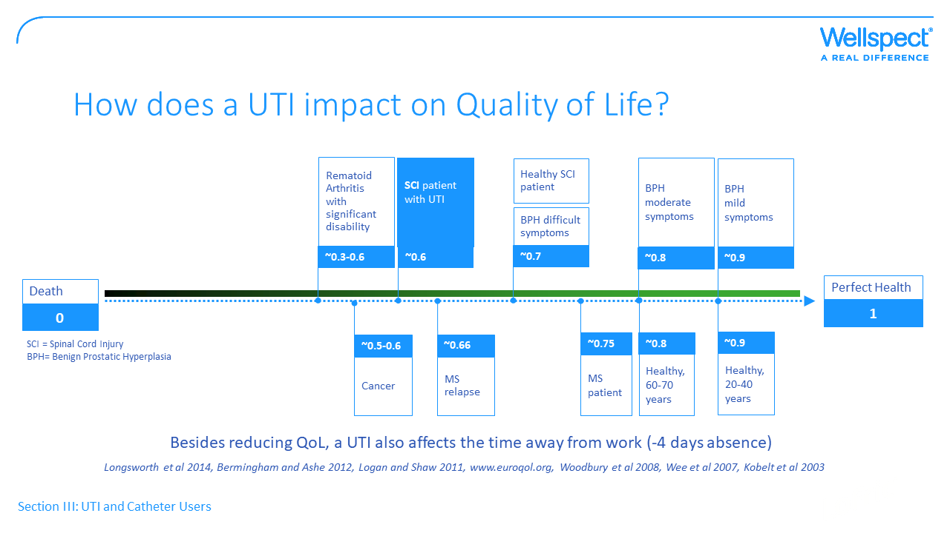
Notes:
A UTI is a relatively serious condition, no matter what situation the patient is in. This slide shows how much a UTI will affect a patient’s QoL. On a scale where death is 0 and perfect health is 1.
Differences between age groups and differences in the experience of UTI depends on if the patient suffers from an additional disease or disability or not. A worsening of a condition often lead to a reduction in QoL of 0,1

Slide 35
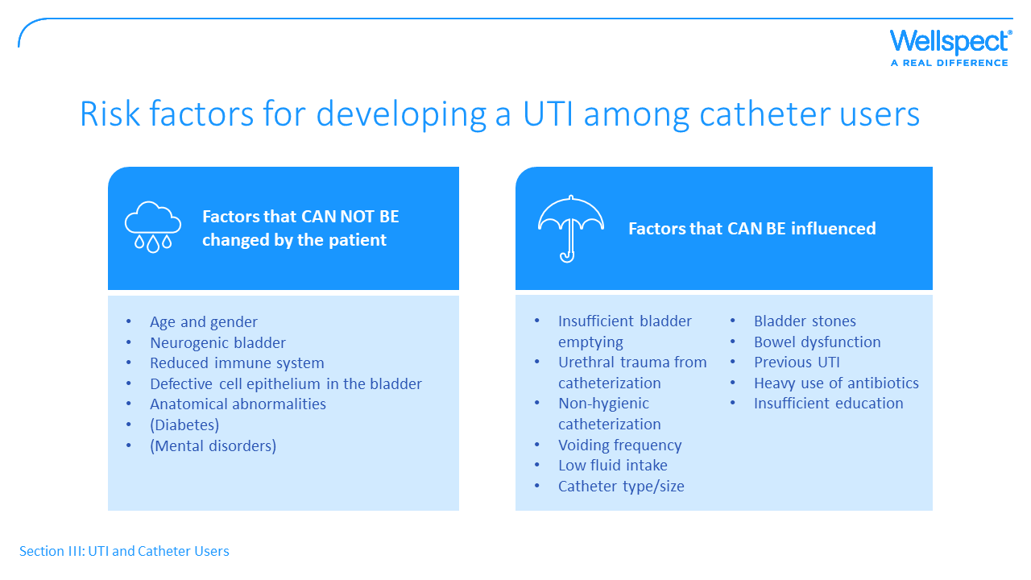
Notes:
In the first section of this material we saw general risk factors for getting a UTI, catheters being one of them. In this section when focusing on the catheter users I have divided the risks in those that can not be changed by the patient, like age, gender, diseases, and those that actually CAN be influenced.

Slide 36
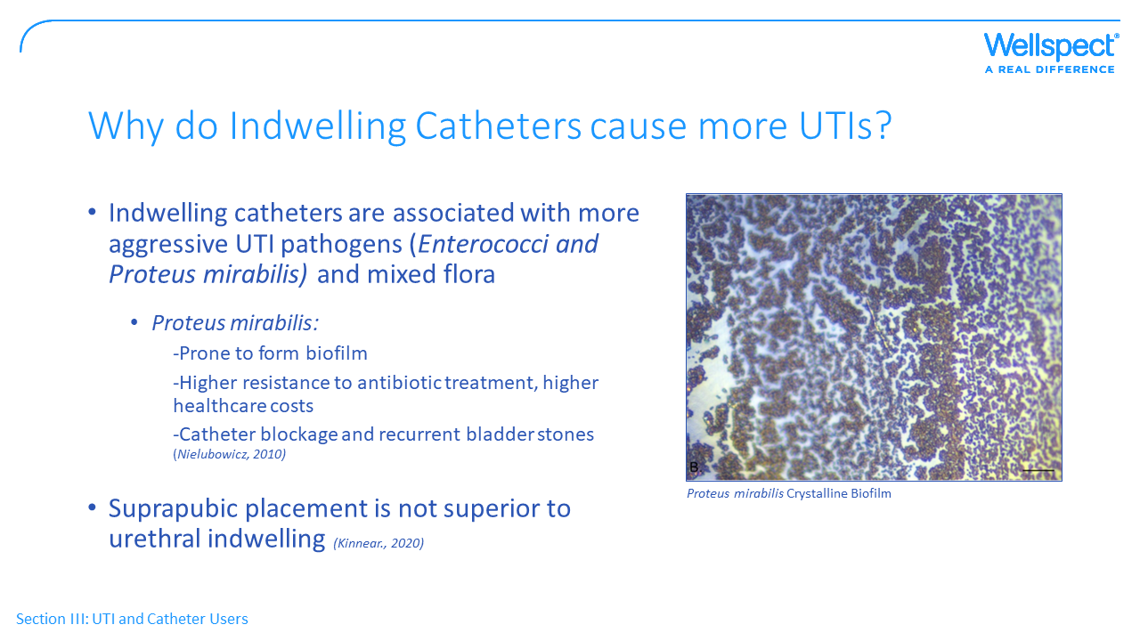
Notes:
The indwelling catheters should be avoided as far as possible and there are plenty of evidence for this.
The first reason is that more aggressive bacteria than E.Coli are causing the UTI, e.g Enterococci and Proteus mirabilis.
Proteus is a bacteria prone to form biofilm, meaning bacteria stick to each other and adhere to the catheter surface by secreting a slimy, glue-like substance. Proteus produce urease, which will raise the urinary pH and drive the formation of calcium phosphate and magnesium phosphate crystals in the biofilm. Making a really hard aggregate which is very difficult for antibiotics to eliminate. Biofilms are troublesome, with infections much harder to treat it will lead to higher healthcare costs, but worse is that it can trigger episodes of kidney infection and sepsis. As well as cause catheter blockage and recurrent bladder stones.
A device in place makes it possible for bacteria to move along the catheter surfaces.
It’s also more common with the presence of several types of bacteria (mixed flora) and this is always more difficult to treat with antibiotics.

Slide 37
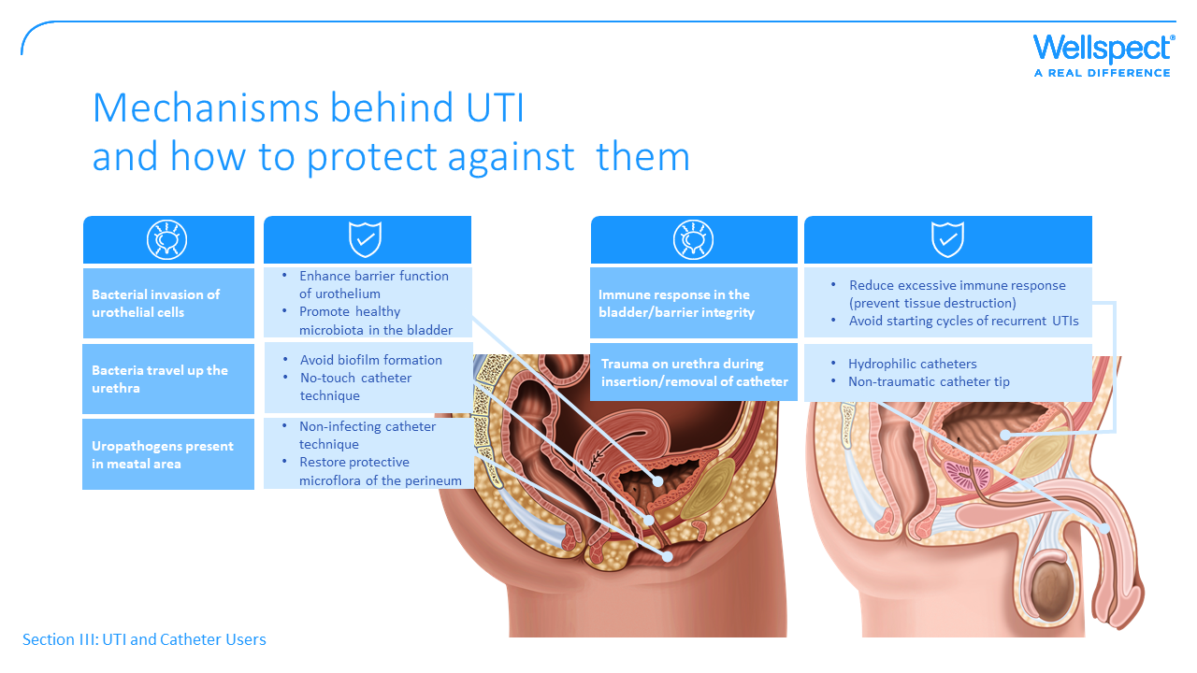
Notes:
This slide illustrates how a problem leading to UTIs may be avoided. Reading from the bottom, box in dark blue, so the problem can be contamination of uropathogens and a Non-infecting catheter technique will be one preventive strategy. Also, trying to not disturb the natural microflora.
The problem with bacteria travel up the urethra is of course most effectively prevented by the use of IC instead of indwelling catheters.
Bacterial invasion of the bladder can be prevented by different ways of enhance barrier function of the urothelium (the cell layers lining the lower urinary tract) . Several autors from the second part UTI research would also claim that you should promote a healthy microbiota, prevent the bacteria to adhere and boost the body’s own immune system.
And trauma of the urethra should be avoided by use of hydrophilic catheters as wells as non-traumatic catheter tip.

Slide 38
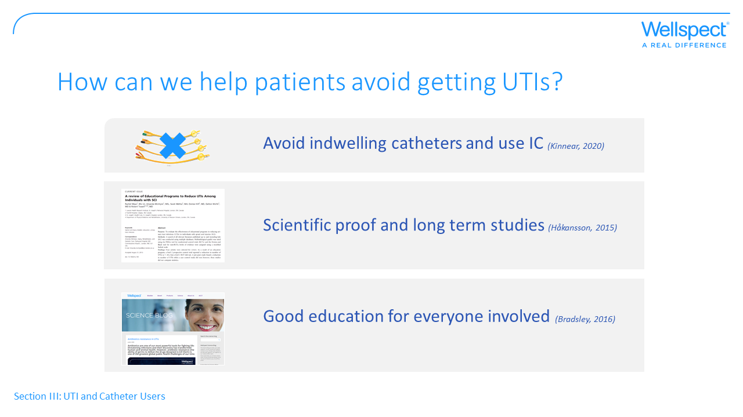
Notes:
We all know that UTIs are part of the therapy, but maybe there are ways to decrease these numbers, and even 1 UTI less per year means a lot both for the individual QoL and for the society as a whole.
The things we can aim for is that always avoid indwelling catheters, show all the scientific proof and long term studies and spread the useful educational material.

Slide 39
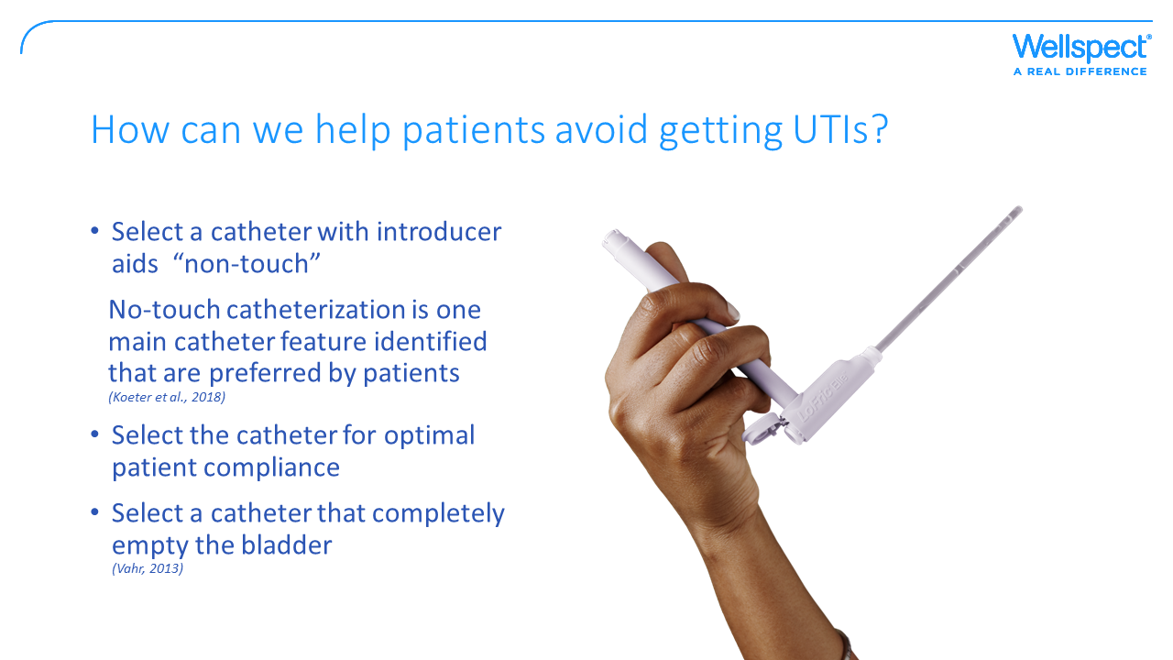
Notes:
Select a catheter which is compliant for each unique patient, with non-touch technique and the typ that will completely empty the bladder. And ask for need of bowel management.

Slide 40
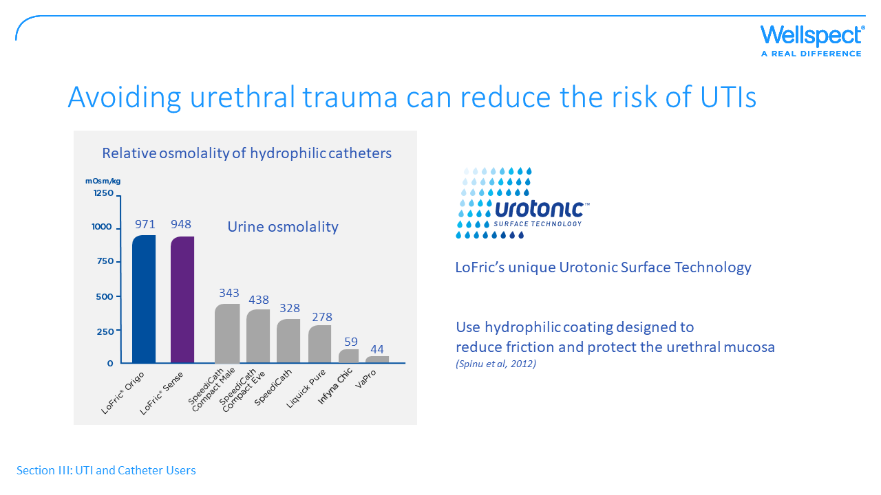
Notes:
In wounds it is always easier for the bacteria to attach and since impossible to wash wounds in the urinary tract it’s very important trying to avoid microtrauma and hematuria. There are evidence of hydrophilic coatings and high osmolality being beneficial for this purpose.

Slide 41
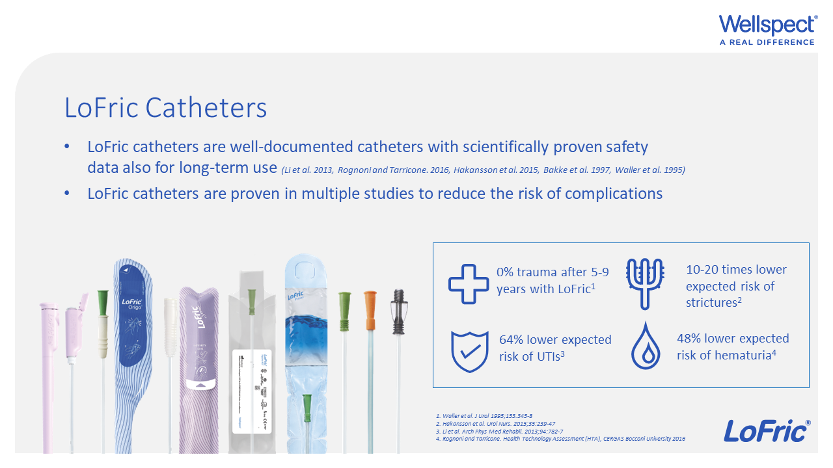
Notes:
We have scientific evidence that LoFric catheters have lower expected risk of trauma, hematuria and UTI. As well as long-term safety.
The unique UrotonicTM Surface Technology associated with LoFric has been well documented and is proven to reduce the risk of complications.
And we have plenty of evidence in favour of our products compared to both indwelling catheters and re-use of catheters.
Remember that residual volume of urine after catheterization is one of the main reasons for UTIs. The LoFric product portfolio have a great range of catheters providing good opportunities to find the best one for each individual patient to completely empty the bladder. And for best compliance.
Key motivators: Safety (LoFric evidence), Health (LoFric evidence)
Questions:
Is it important to you to choose a safe and well-documented catheter when recommending intermittent catheters to users?

Slide 42
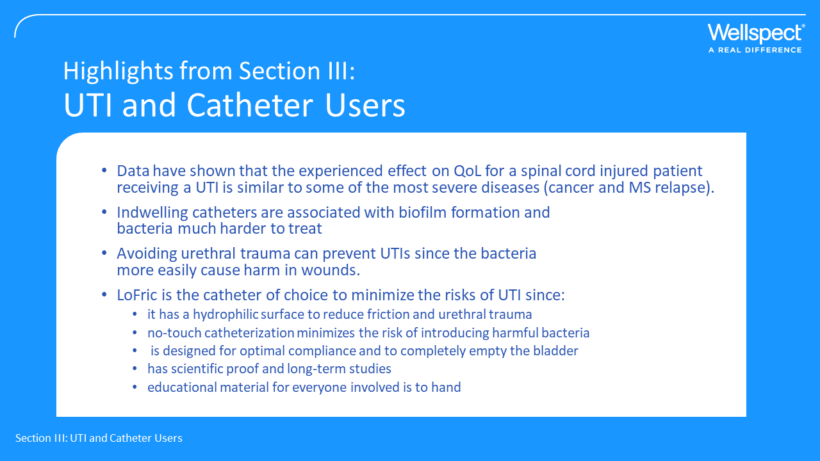
Notes:
UTI is something that affects the patient’s QoL quite a lot
Indwelling catheters make some aggressive bacteria travel along the catheter and form crystalline clusters called biofilms, very hard to get rid of.
UTIs may be reduced by using LoFric catheters:
-to reduce friction and urethral trauma
-minimizing risks of introducing harmful bacteria
-to completely empty the bladder
-with scientific proof and long term studies
-Good educatio for everyone involved (patient, caregiver, HCP)

Slide 43
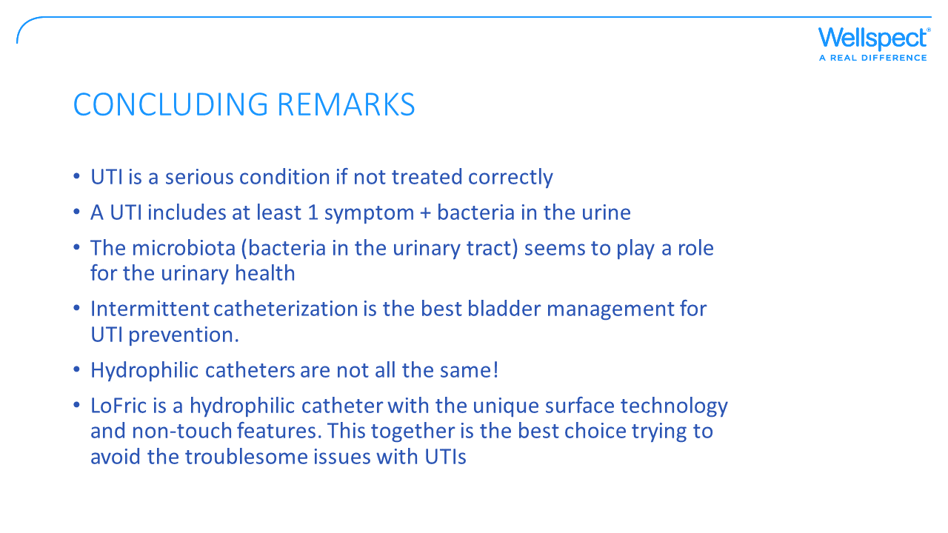
Notes:
We should all remember that UTIs ARE troublesome issues. Untreated they can be life-threatning and everyone needs to do what we can to keep antibiotics a powerful and effective treatment also for coming generations.
Even though the antibiotic resistance is caused by all types of infections, not only UTIs, this is the situation right now. A catheter user living in one of those countries with high numbers of multidrug resistent strains will have more trouble getting rid of the infection. Let’s do what we can trying to minimize that risk.

Slide 44


